Slide 1

NEXT
EPAM SEC 2017
ENGINEERING
Community building through education
Dzmitry Varabei
SEPTEMBER 16

Slide 2
PART I. About

Slide 3



#rollingscopes

Slide 4
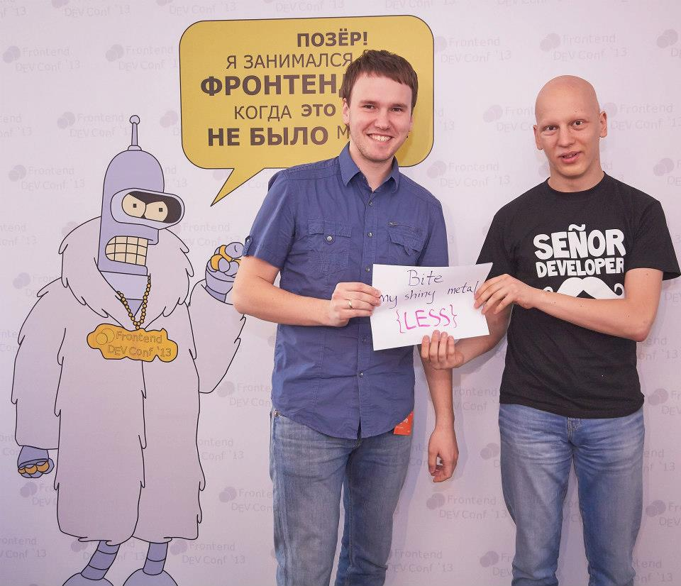
4 years ago

Slide 5
Community around:
HTML
CSS
JS
Node.js

Slide 6
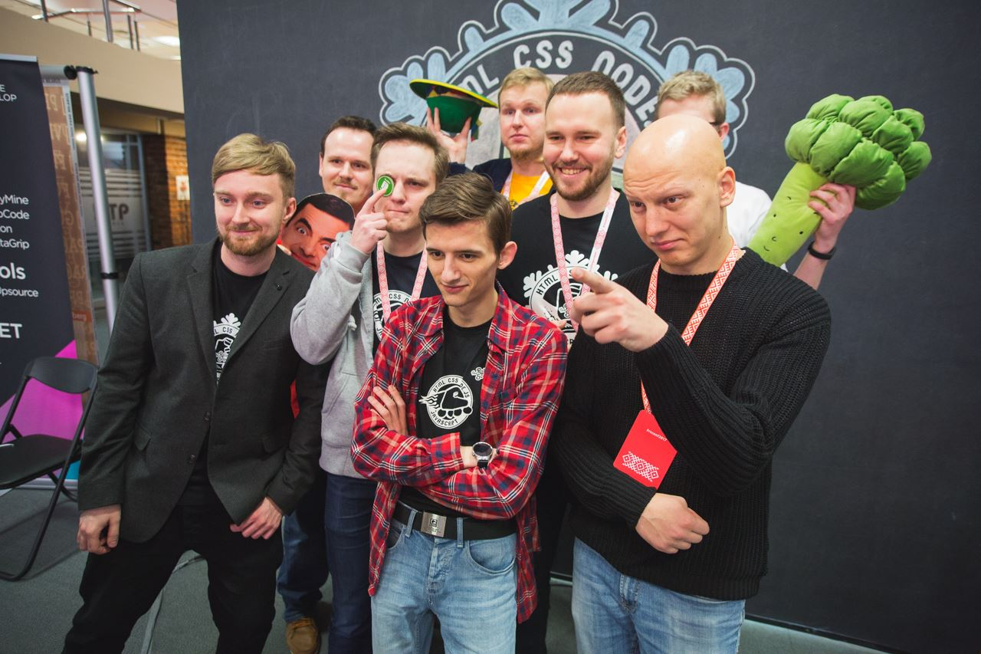
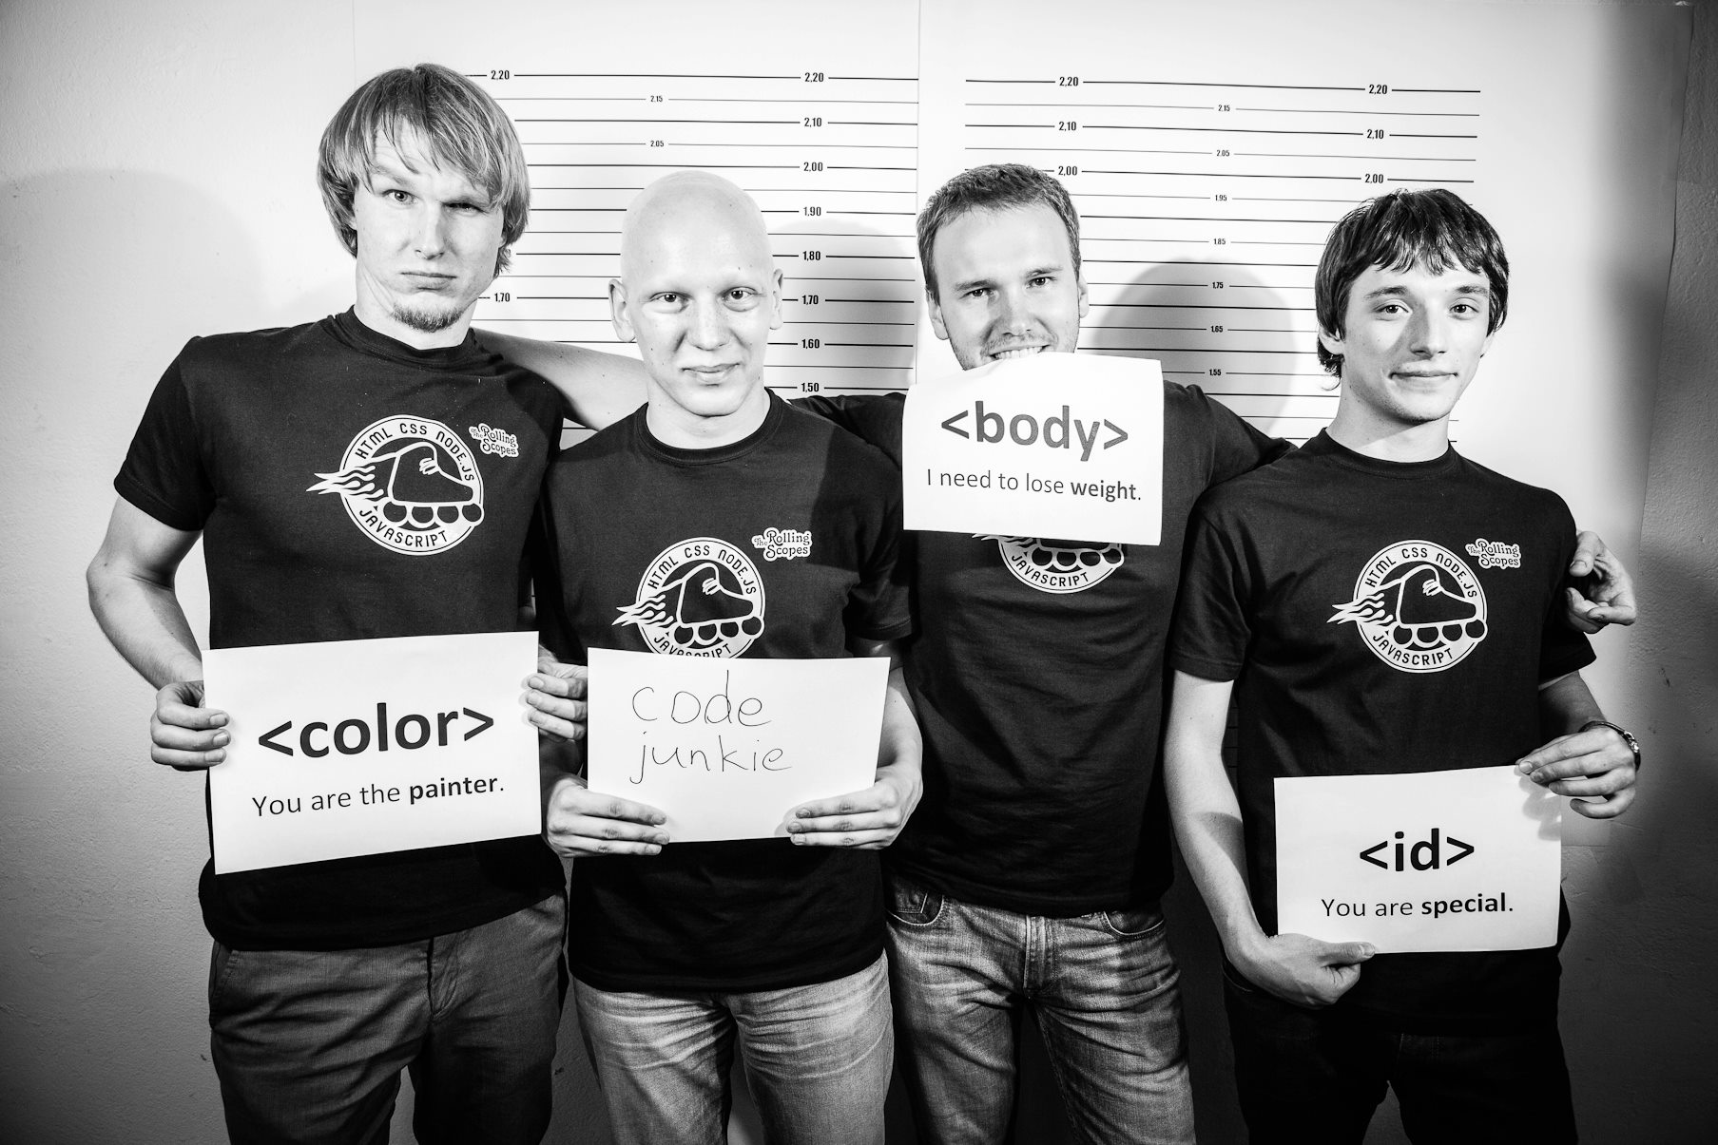
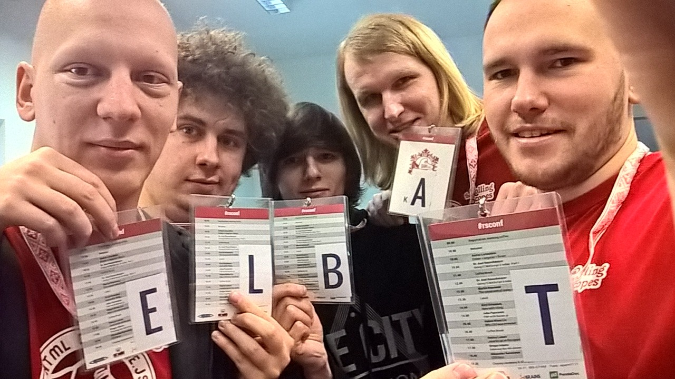
Built a crew

Slide 7
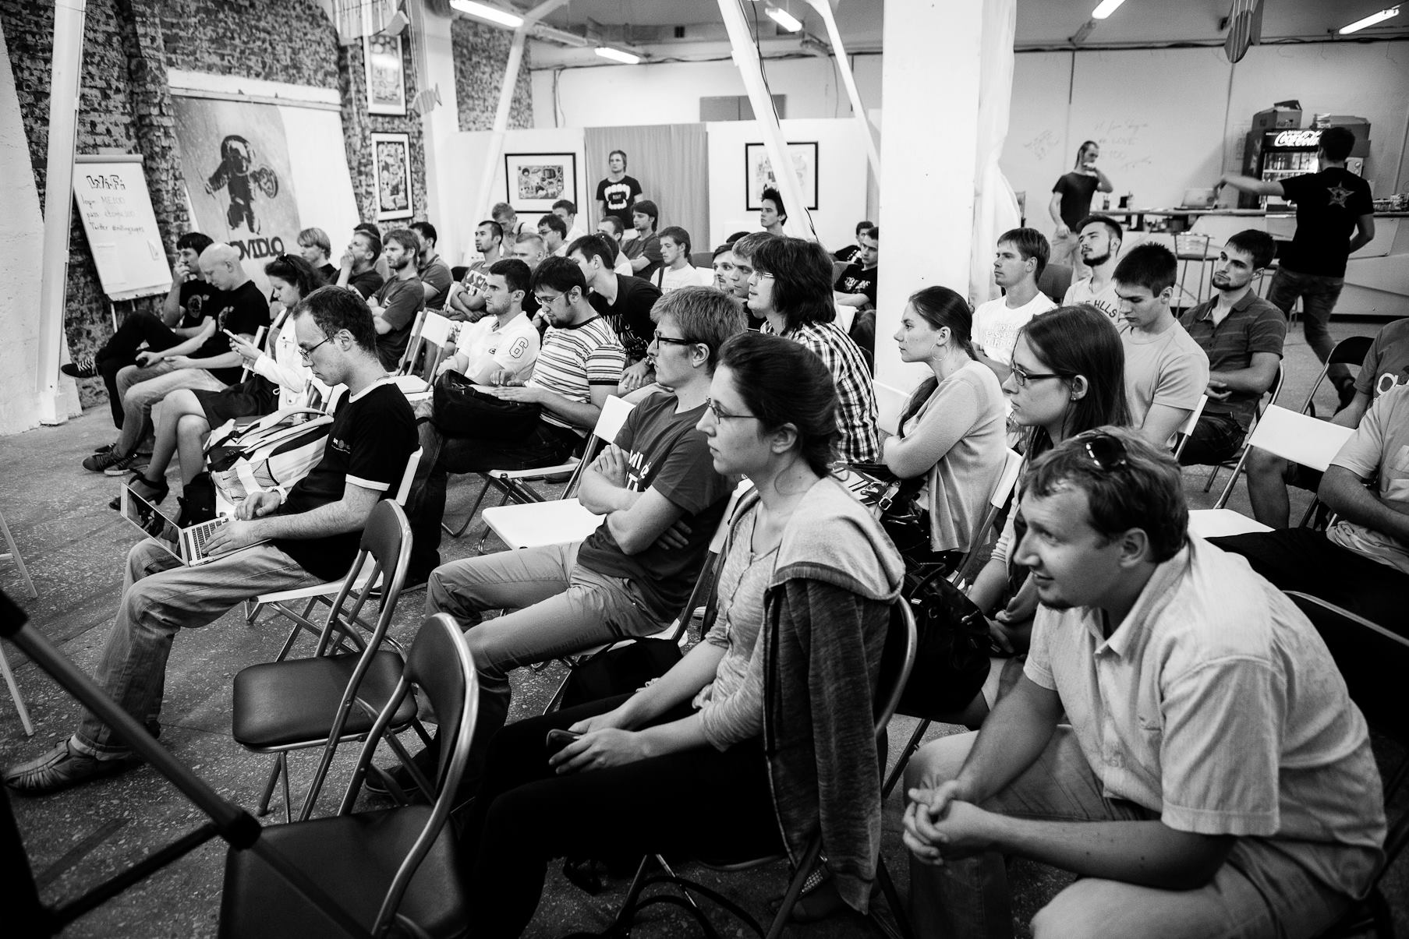
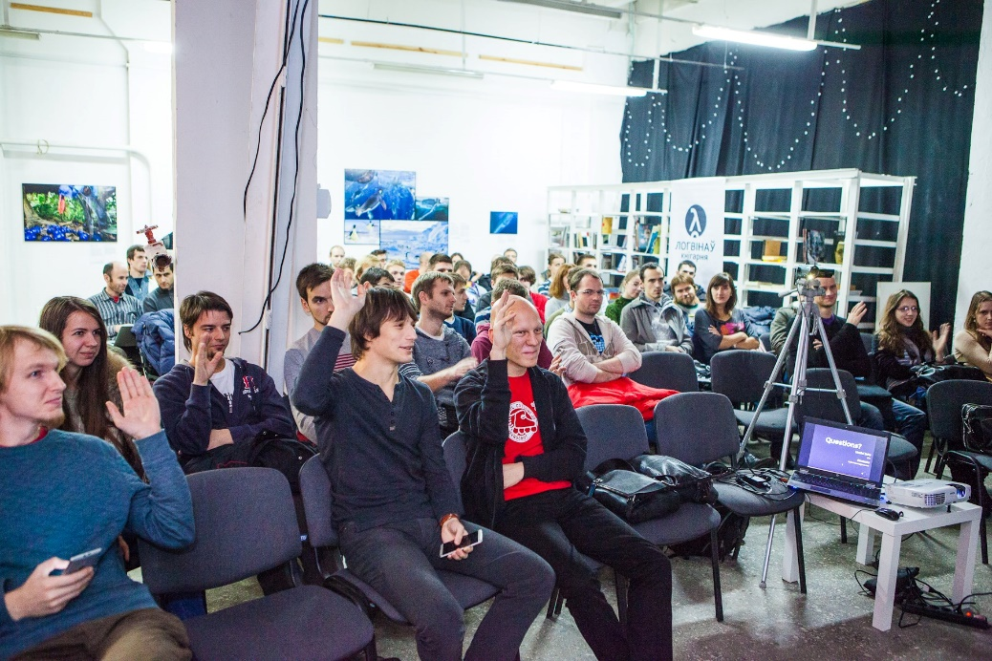
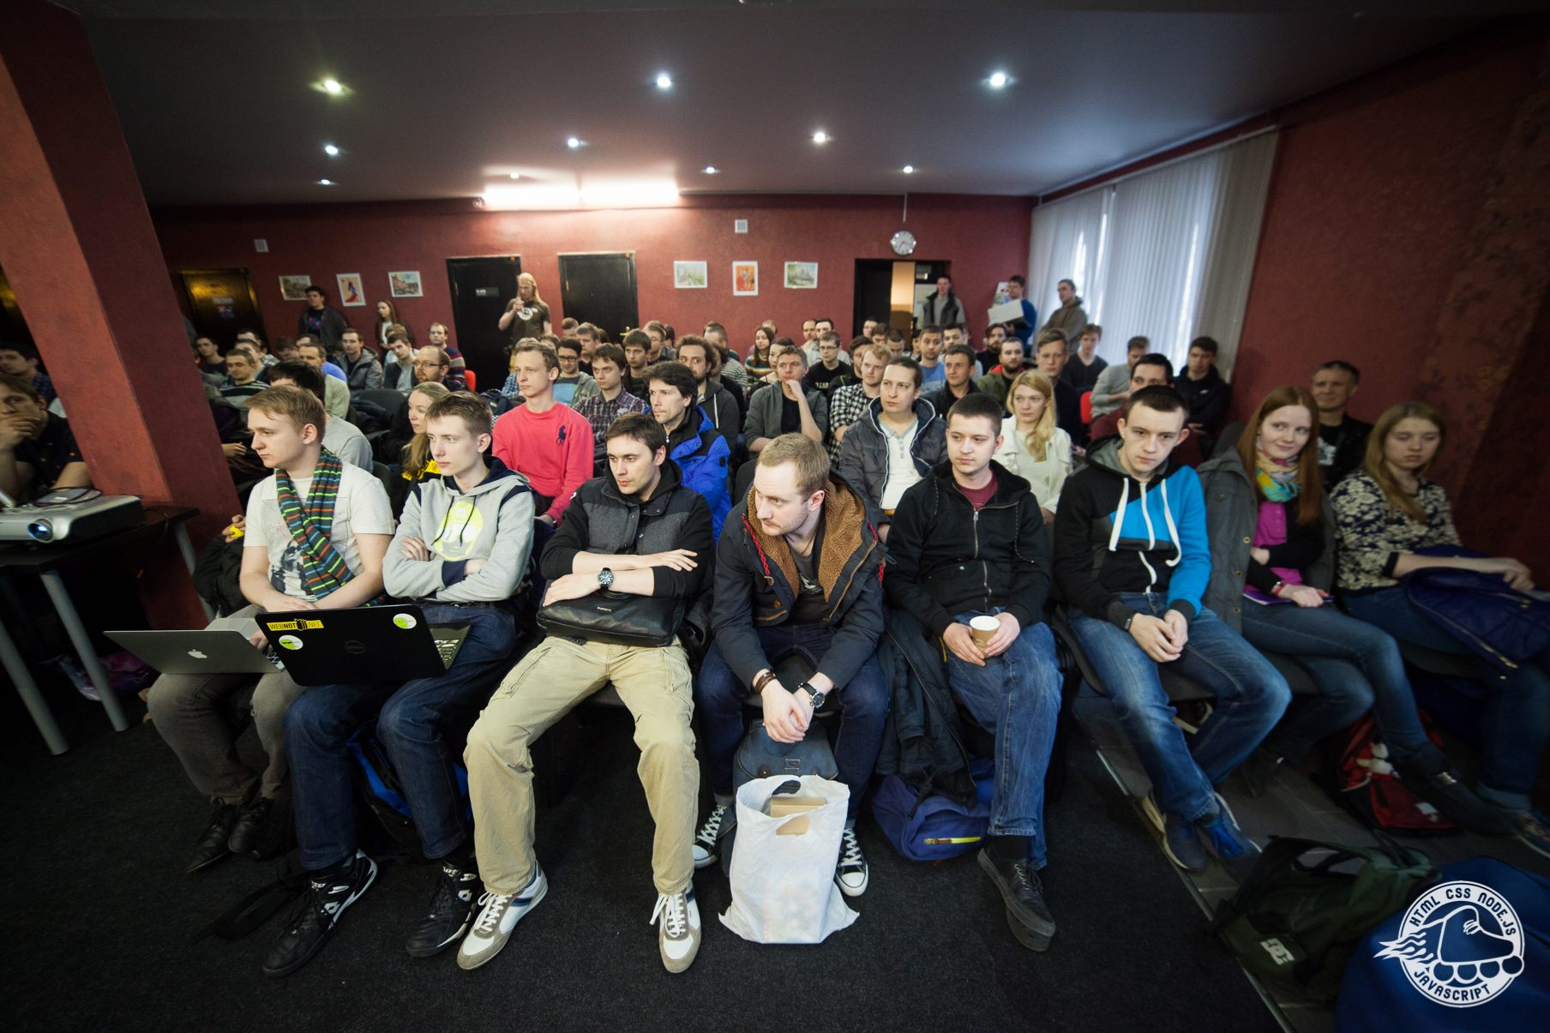
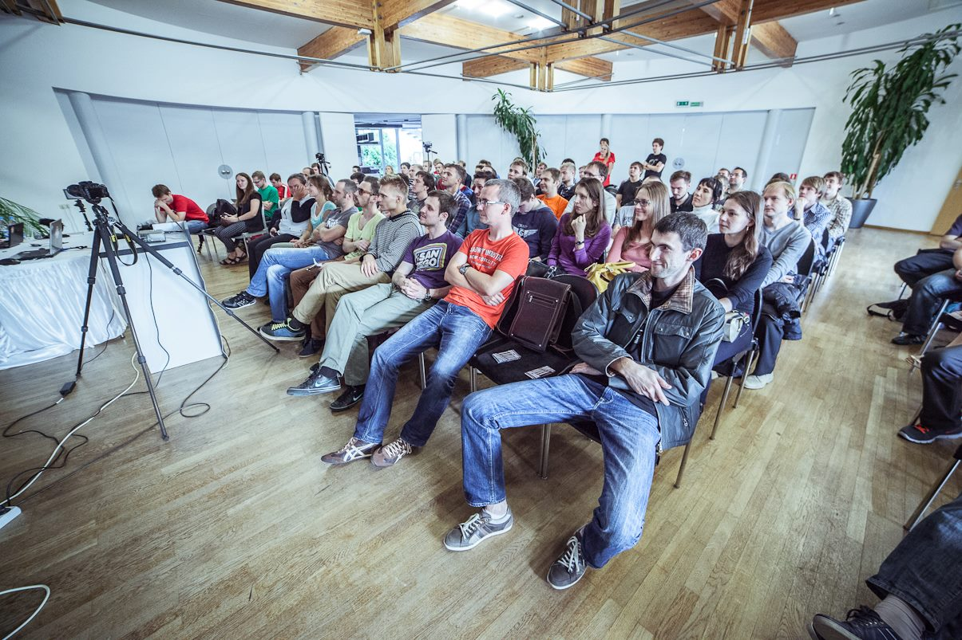
40+ Meetups

Slide 8
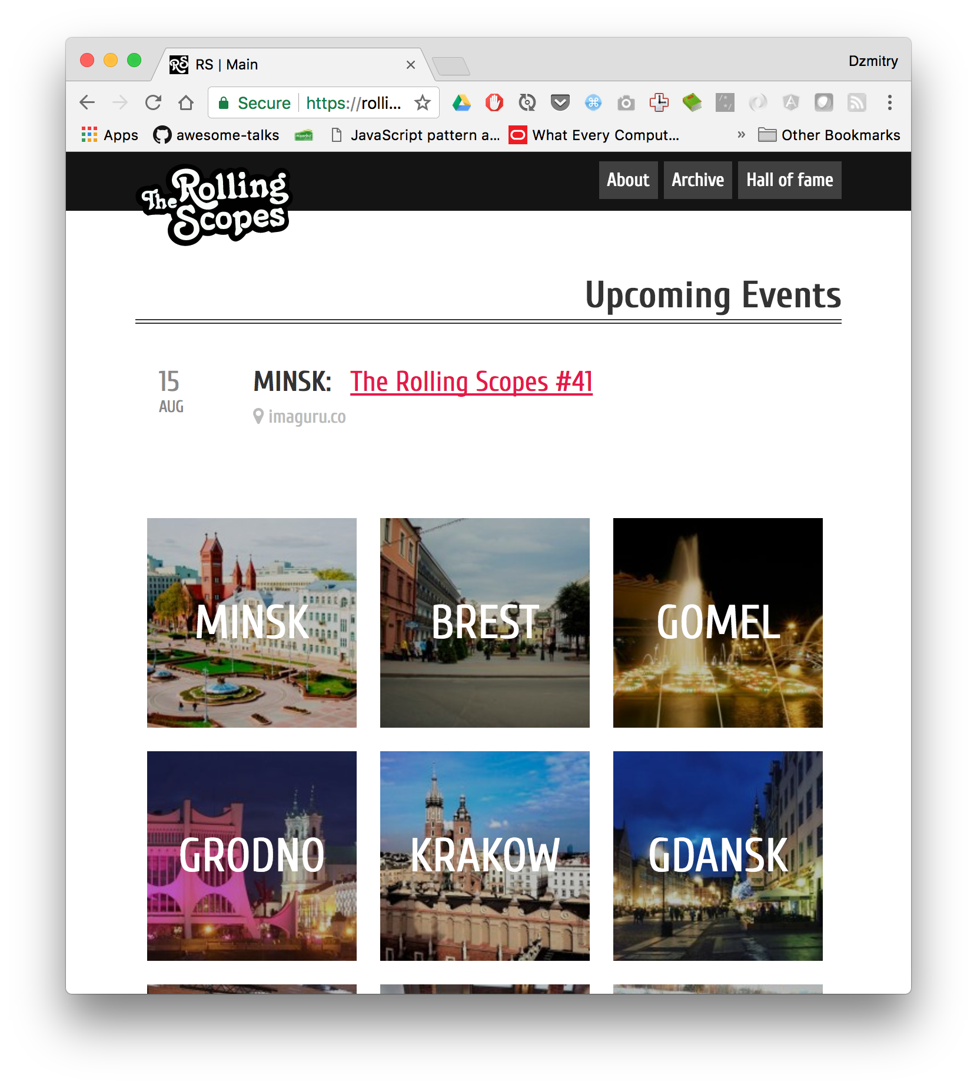

Slide 9
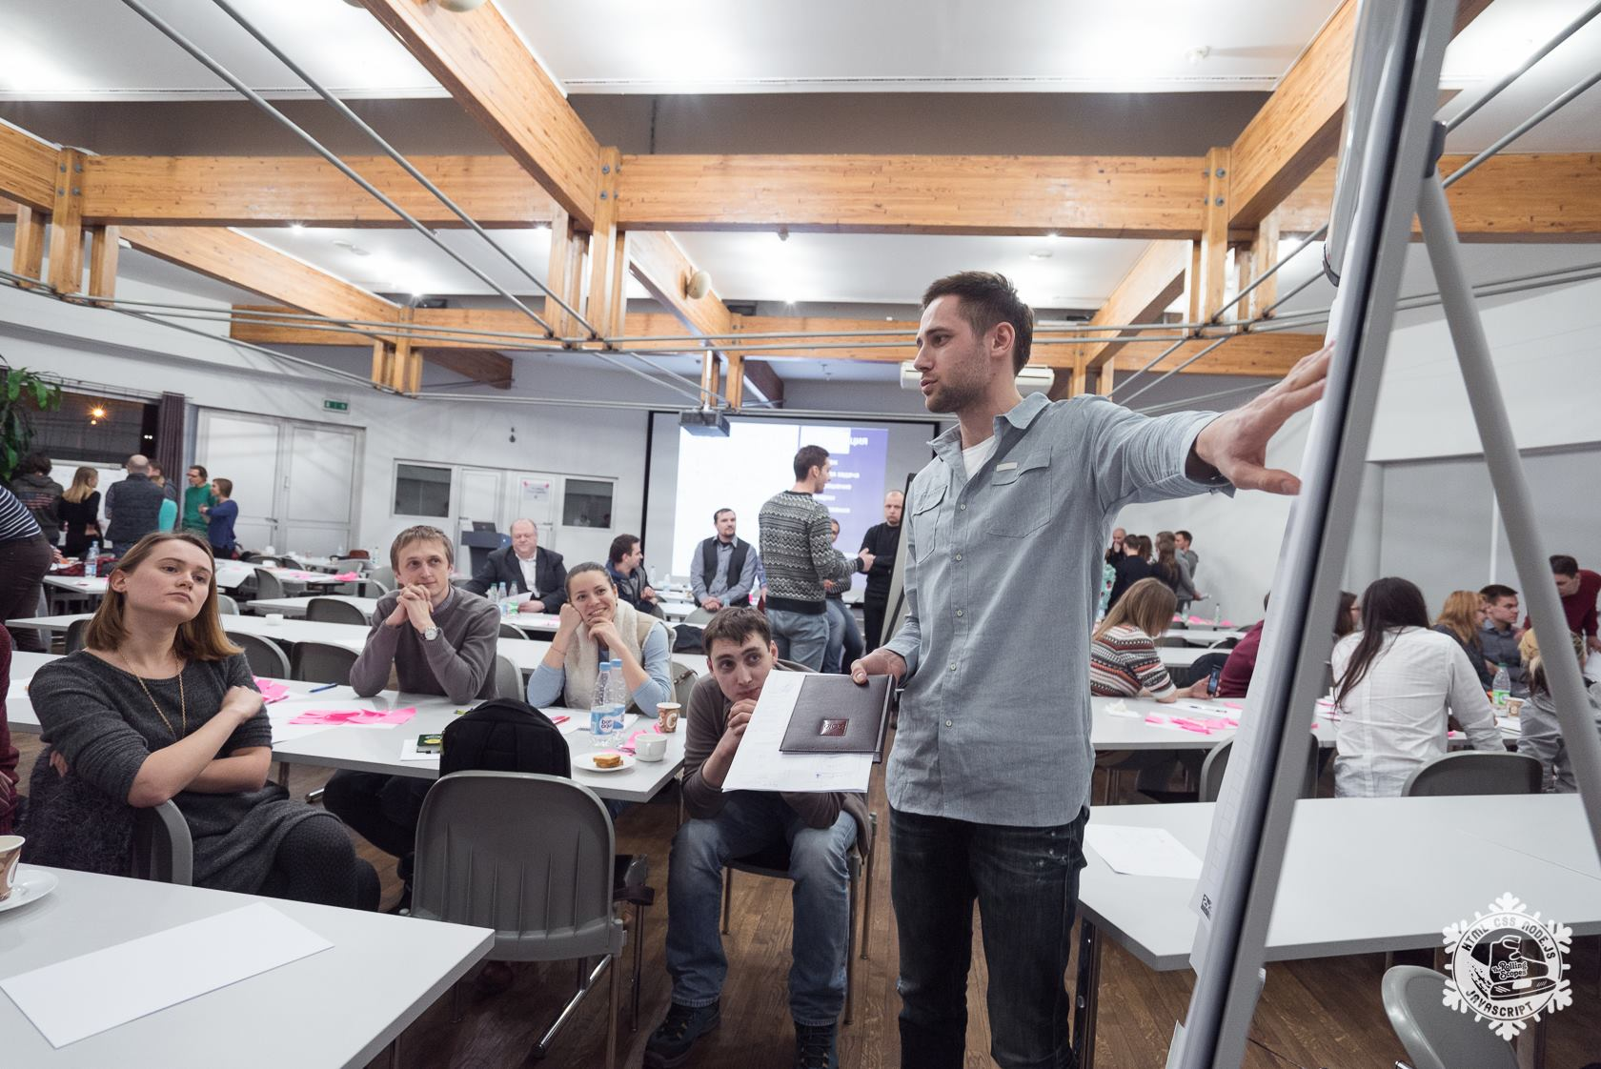
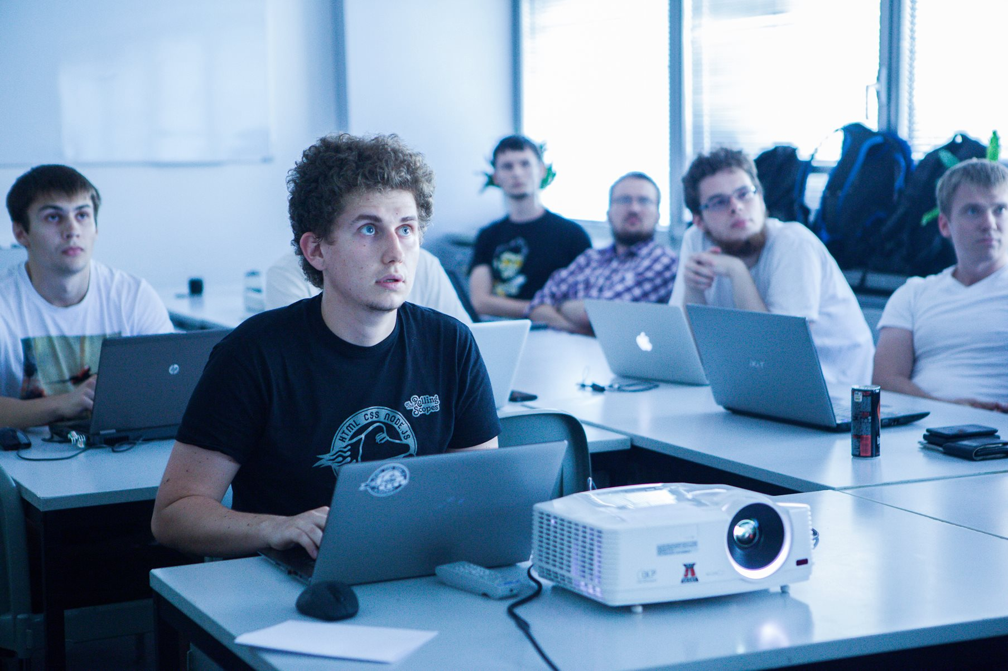
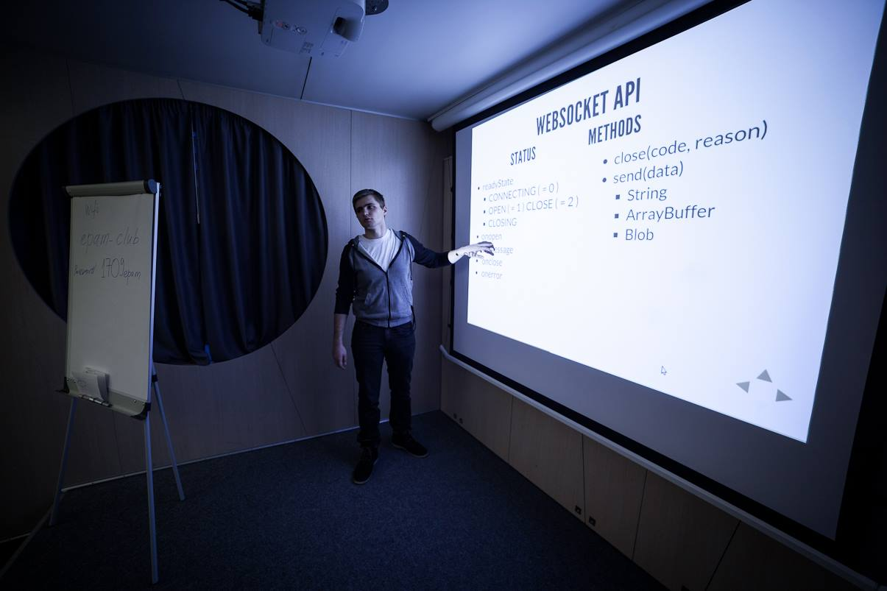
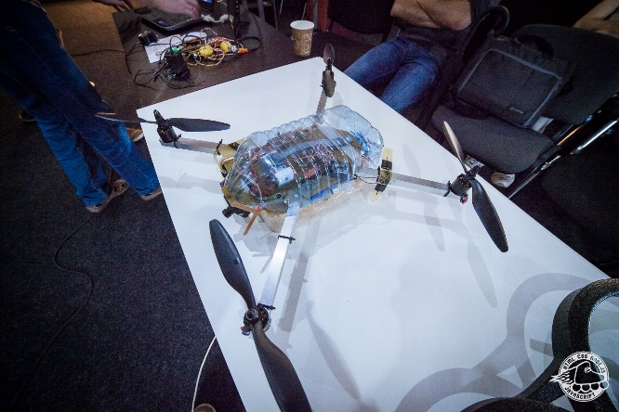
as well as workshops

Slide 10

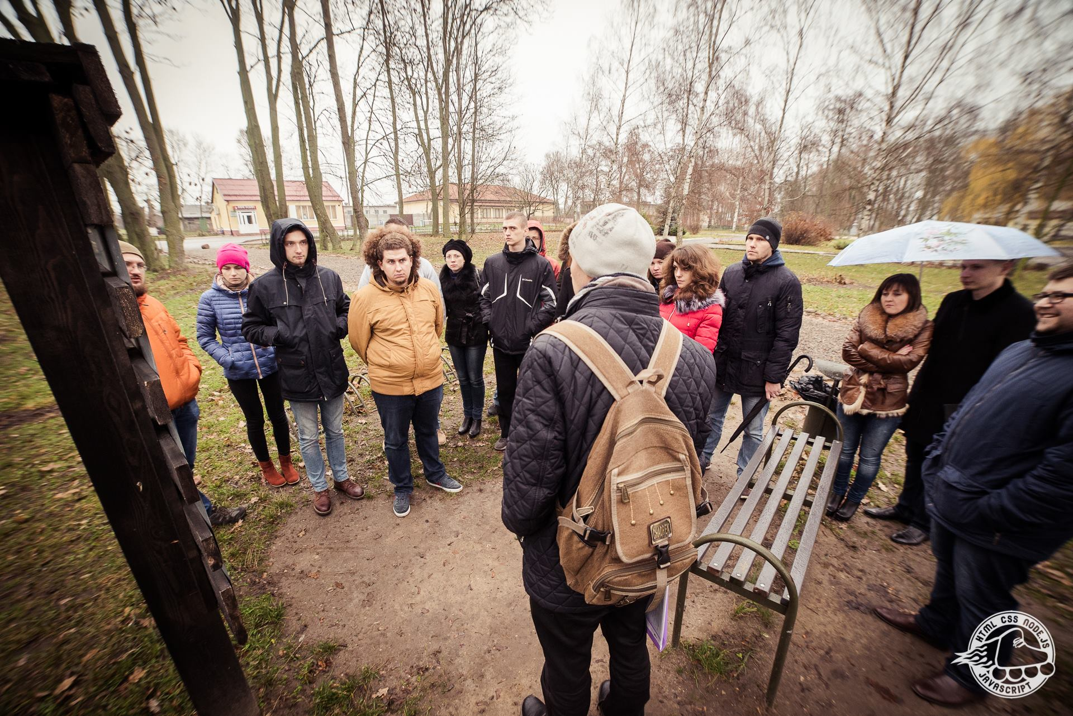
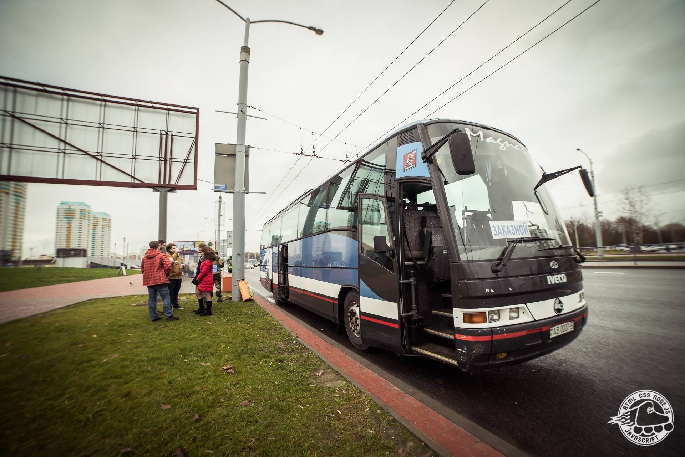
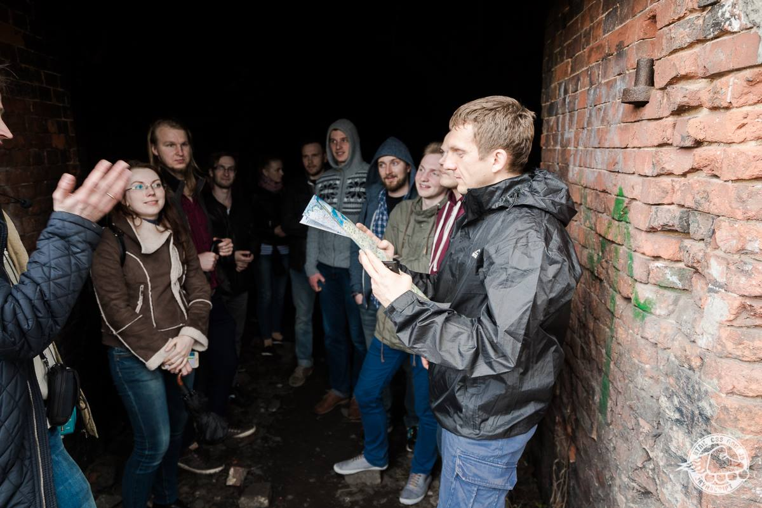
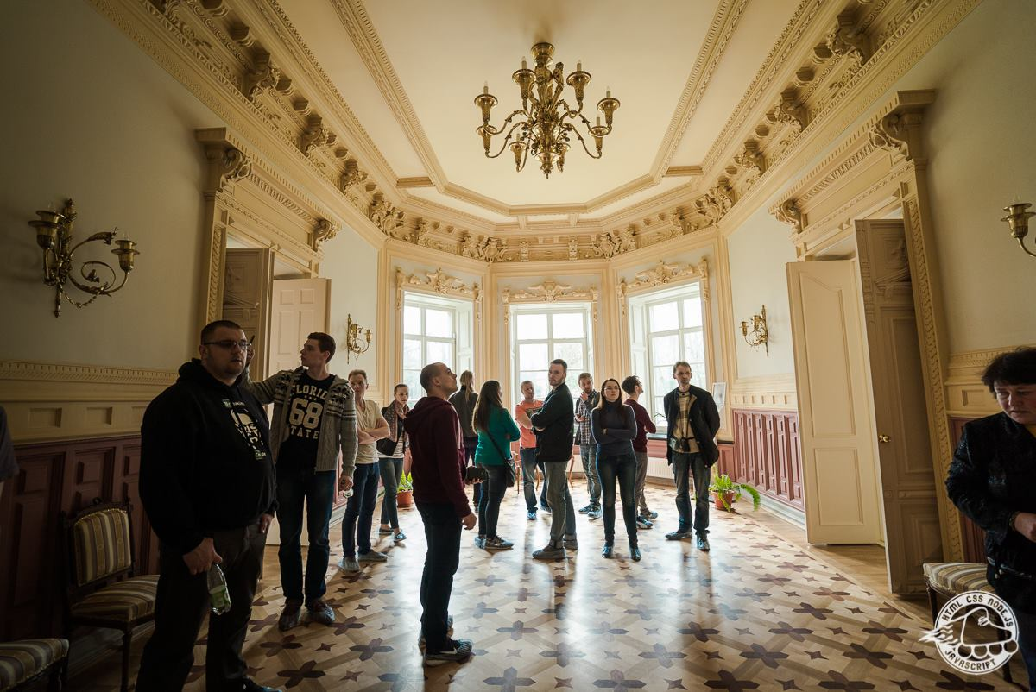
as well as on tour meetups

Slide 11
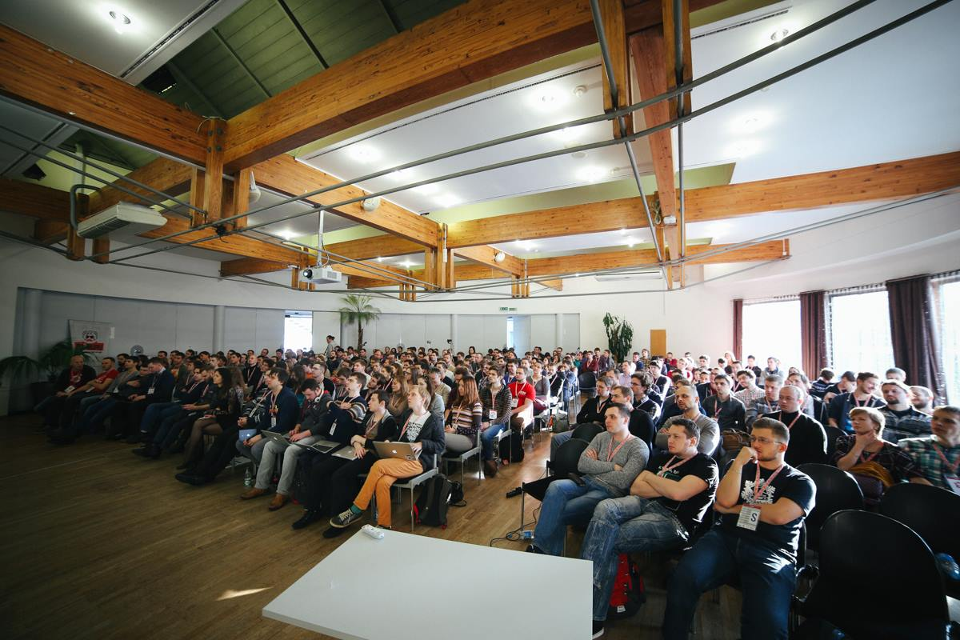
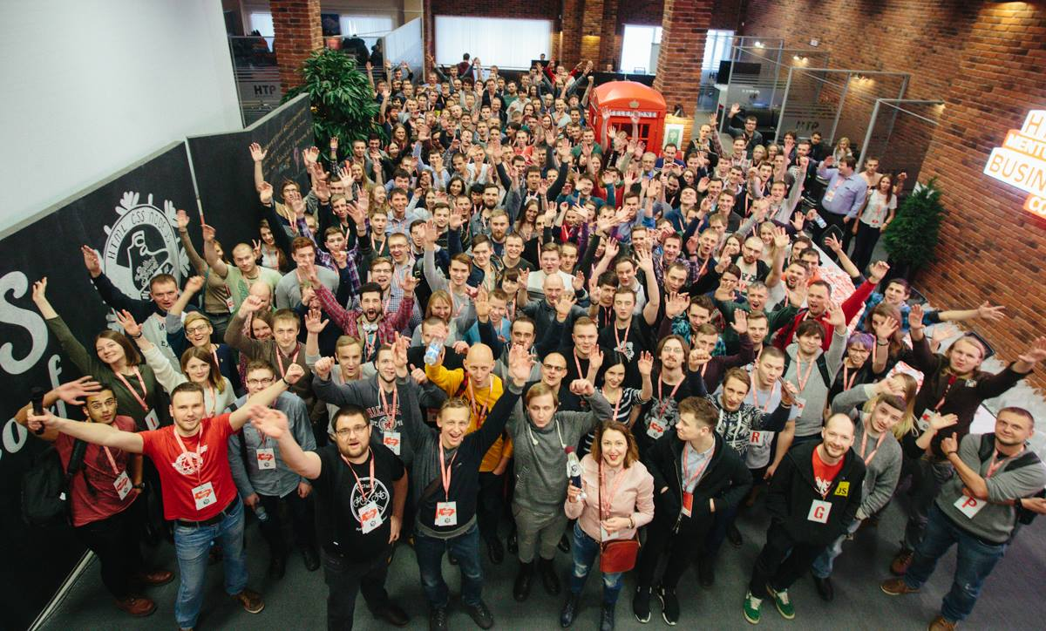
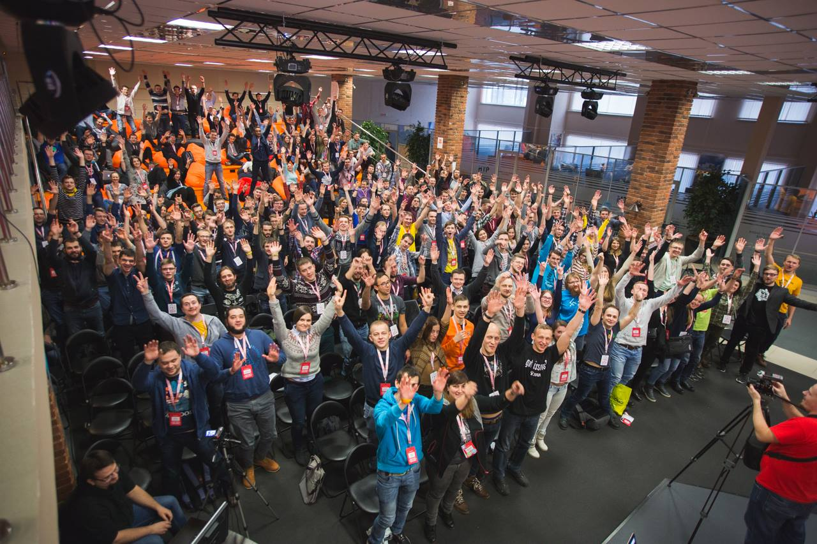
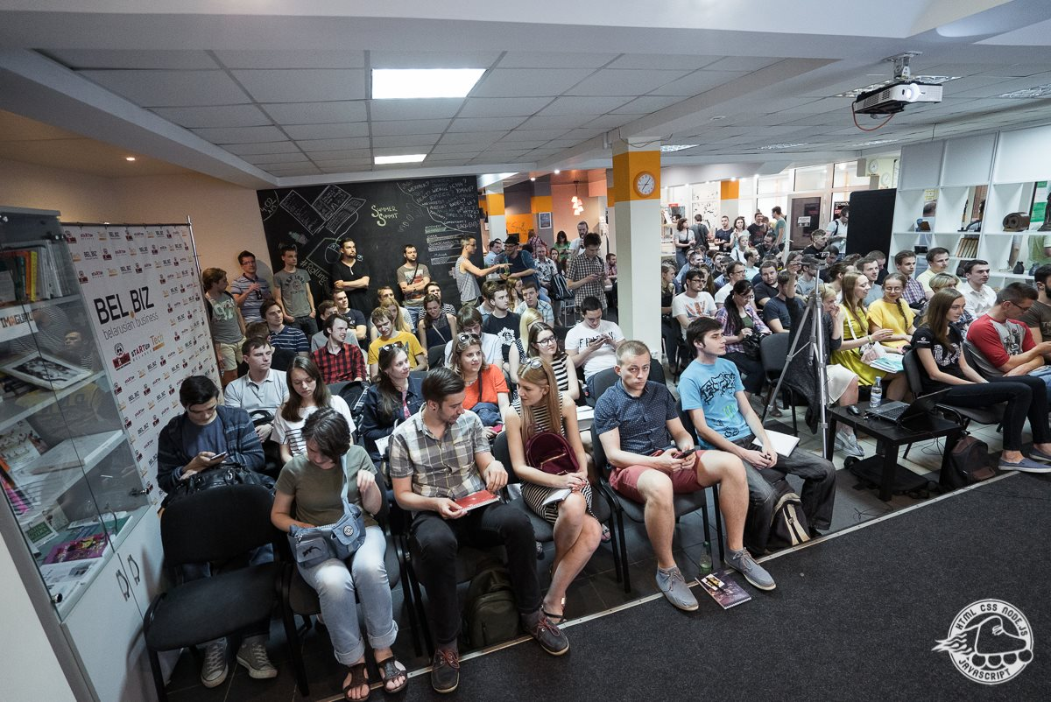
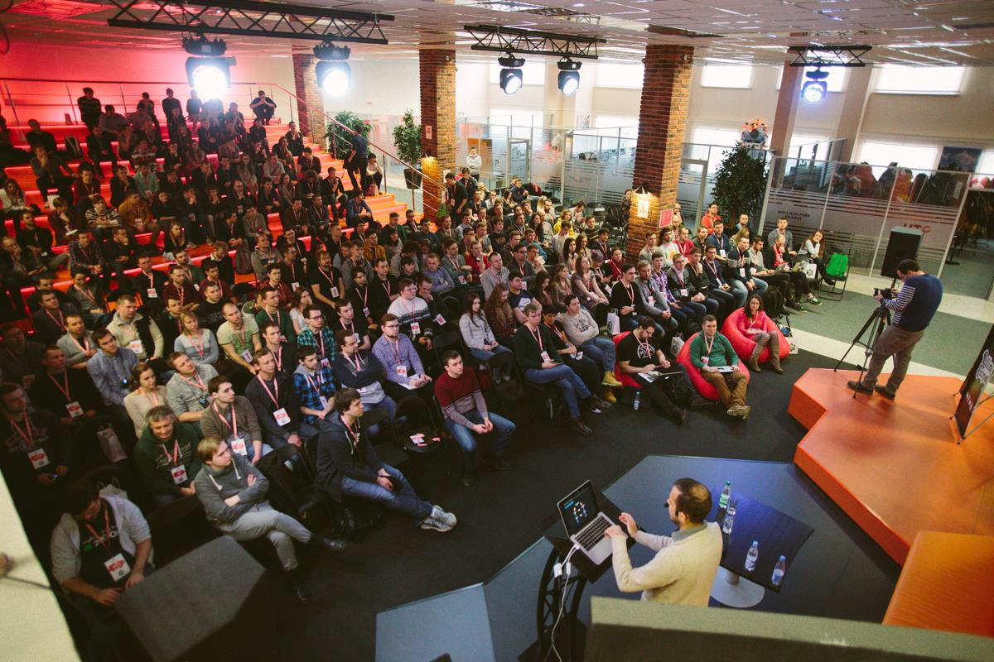
5 Conferences

Slide 12
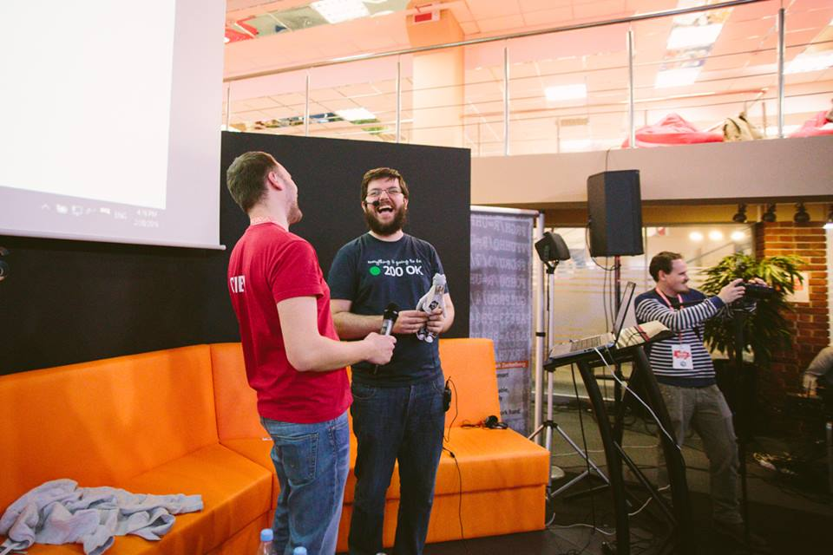
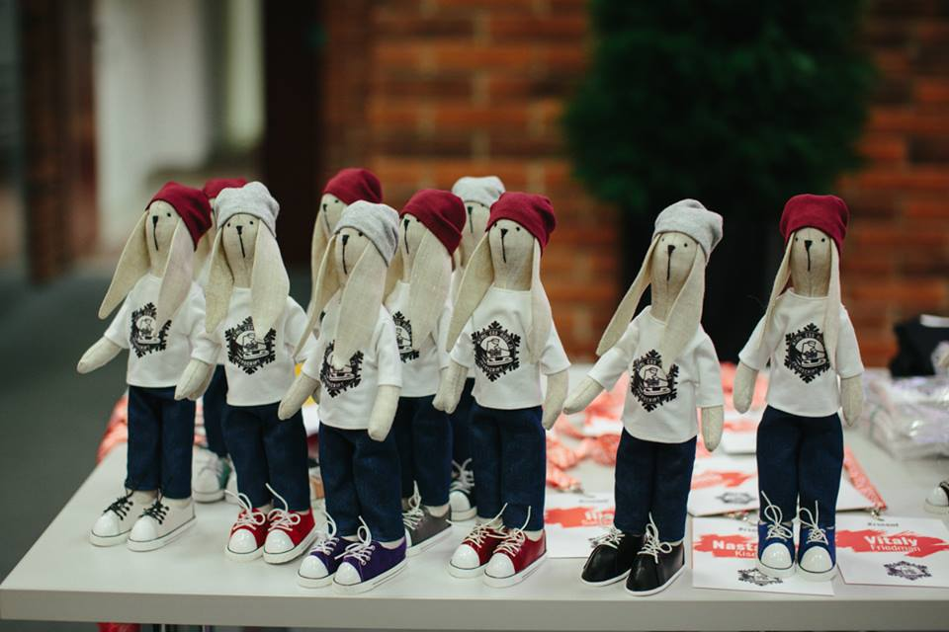
Oscars for Speakers

Slide 13
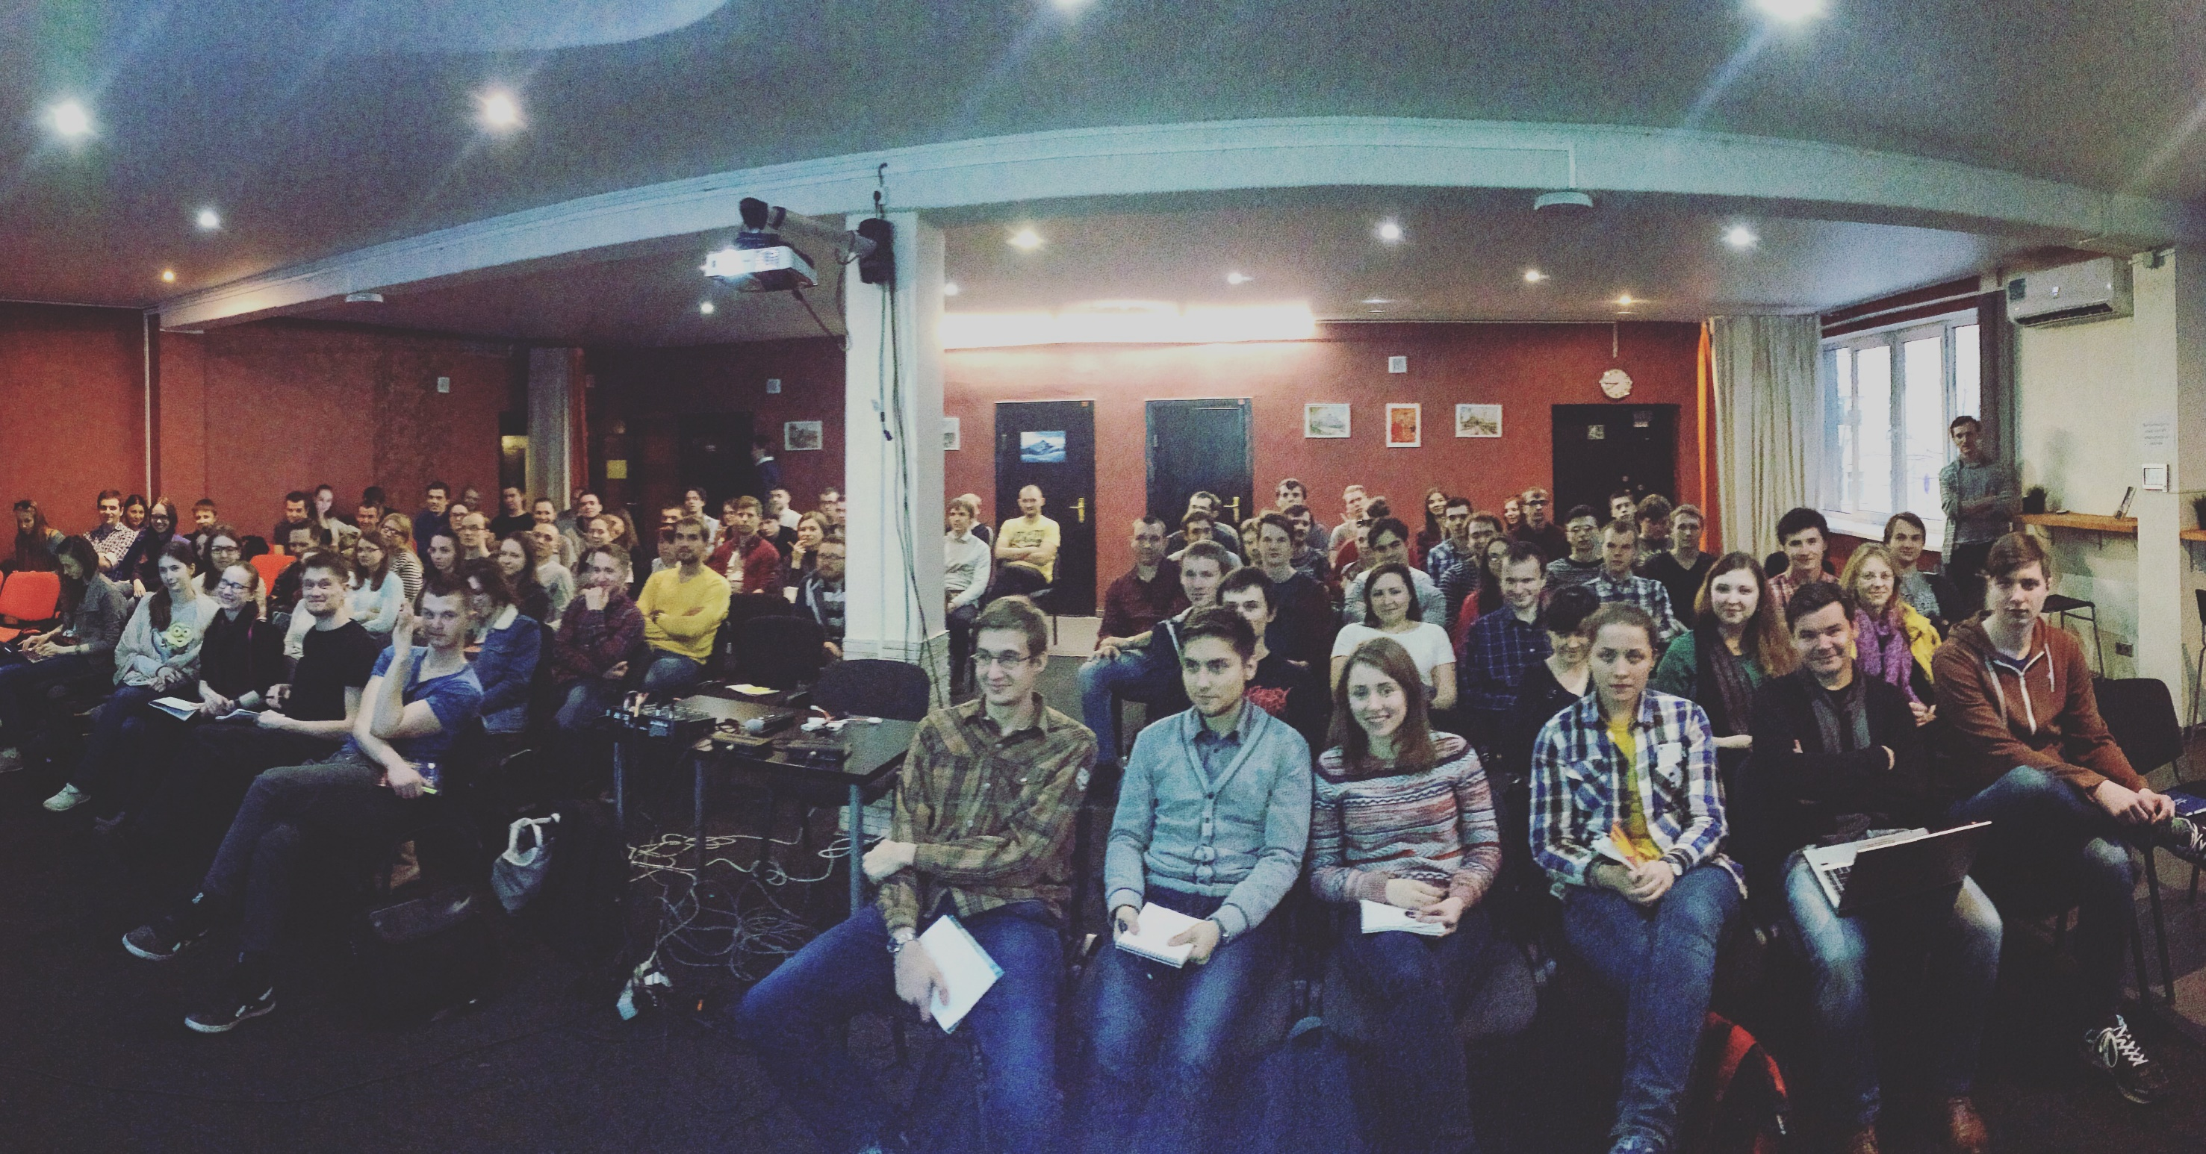
The Rolling Scopes School

Slide 14
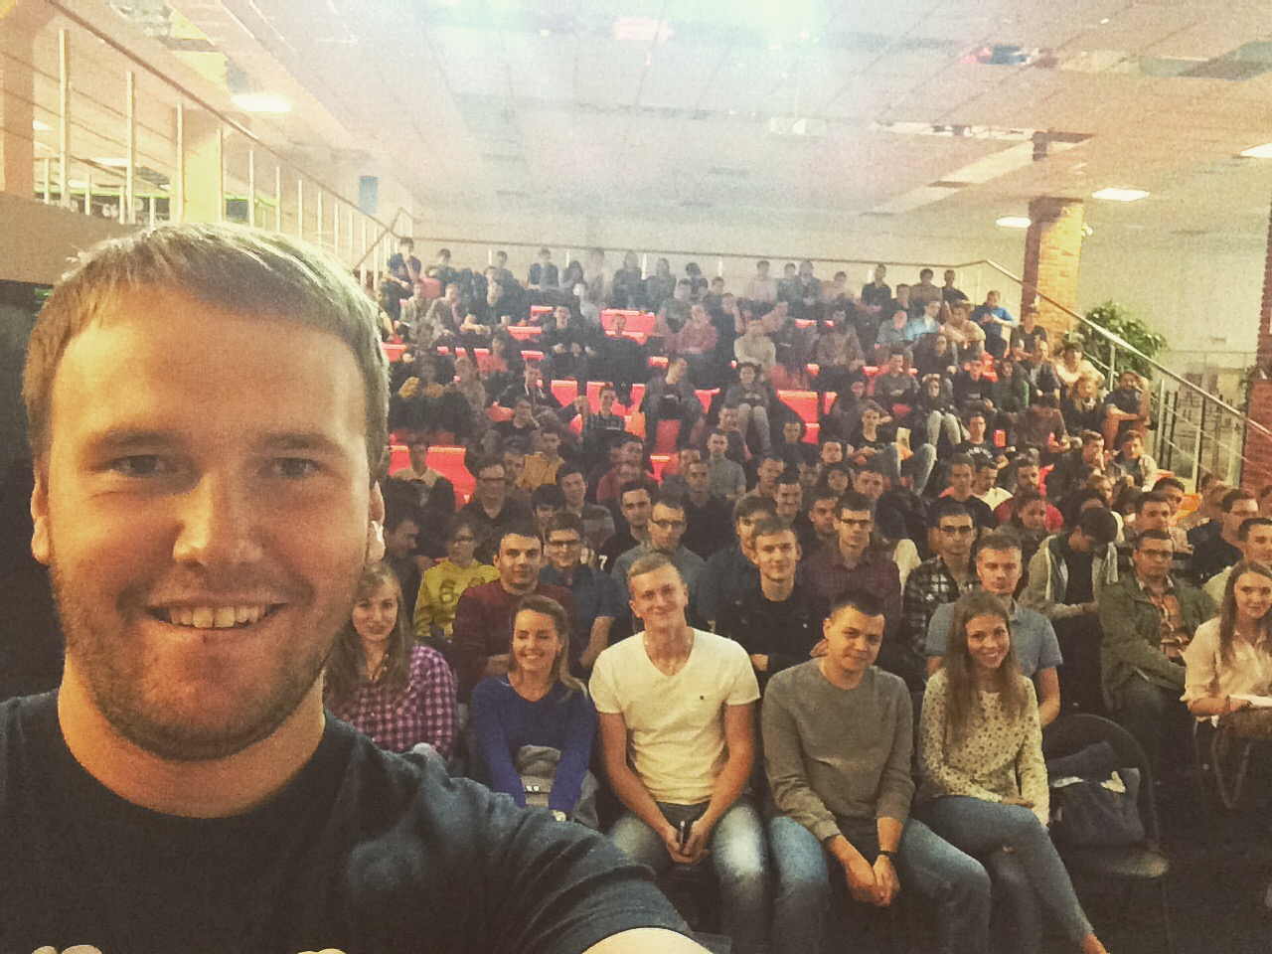
Now we grow 250 junior software engineers per semester

Slide 15
PART II
How we do this?

Slide 16
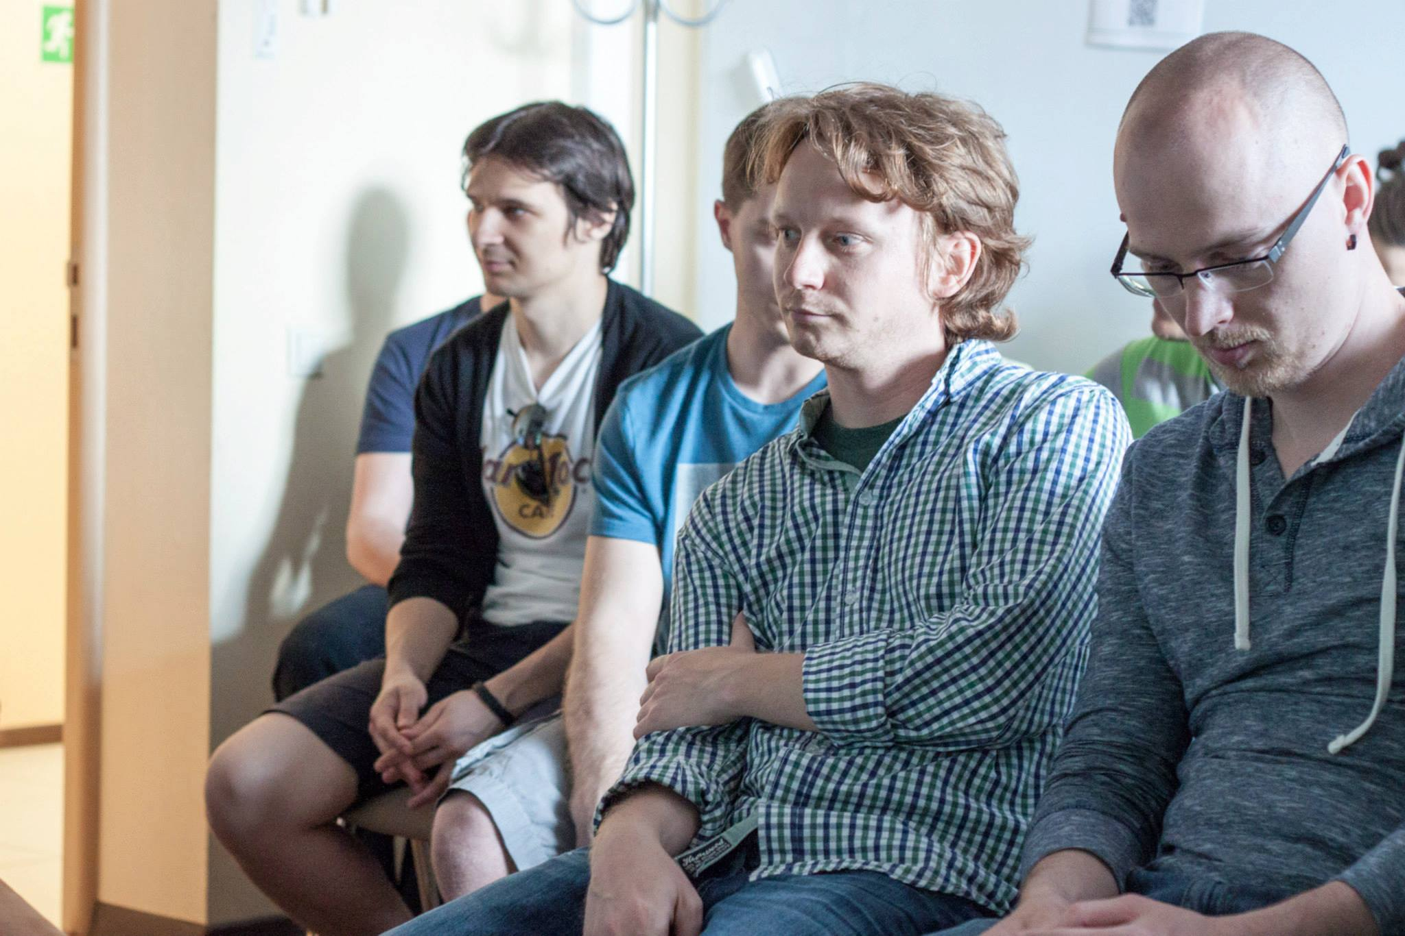
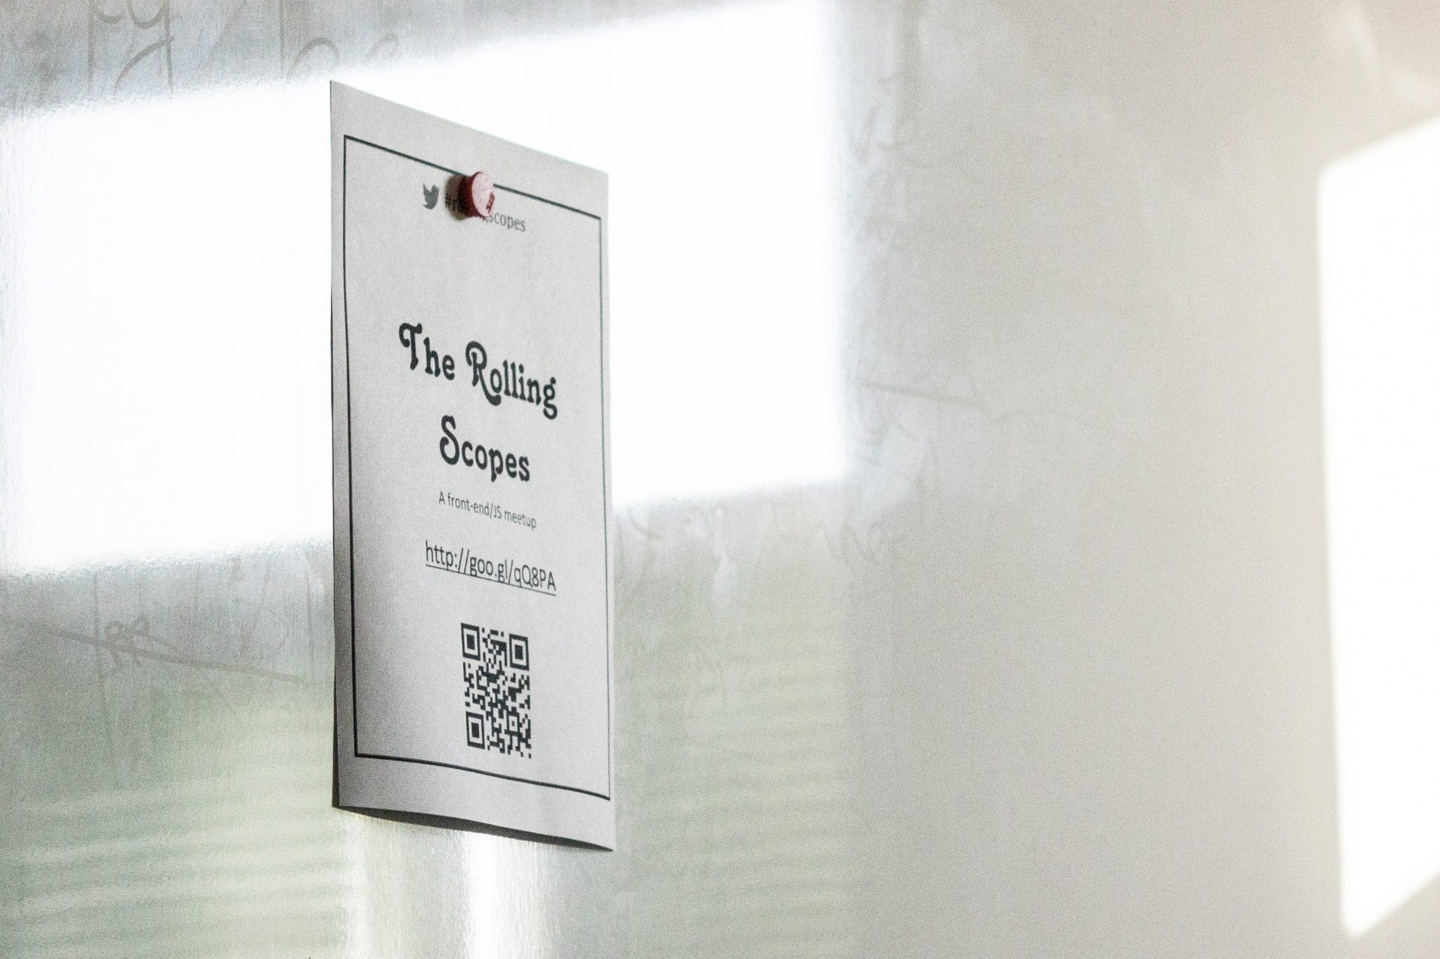
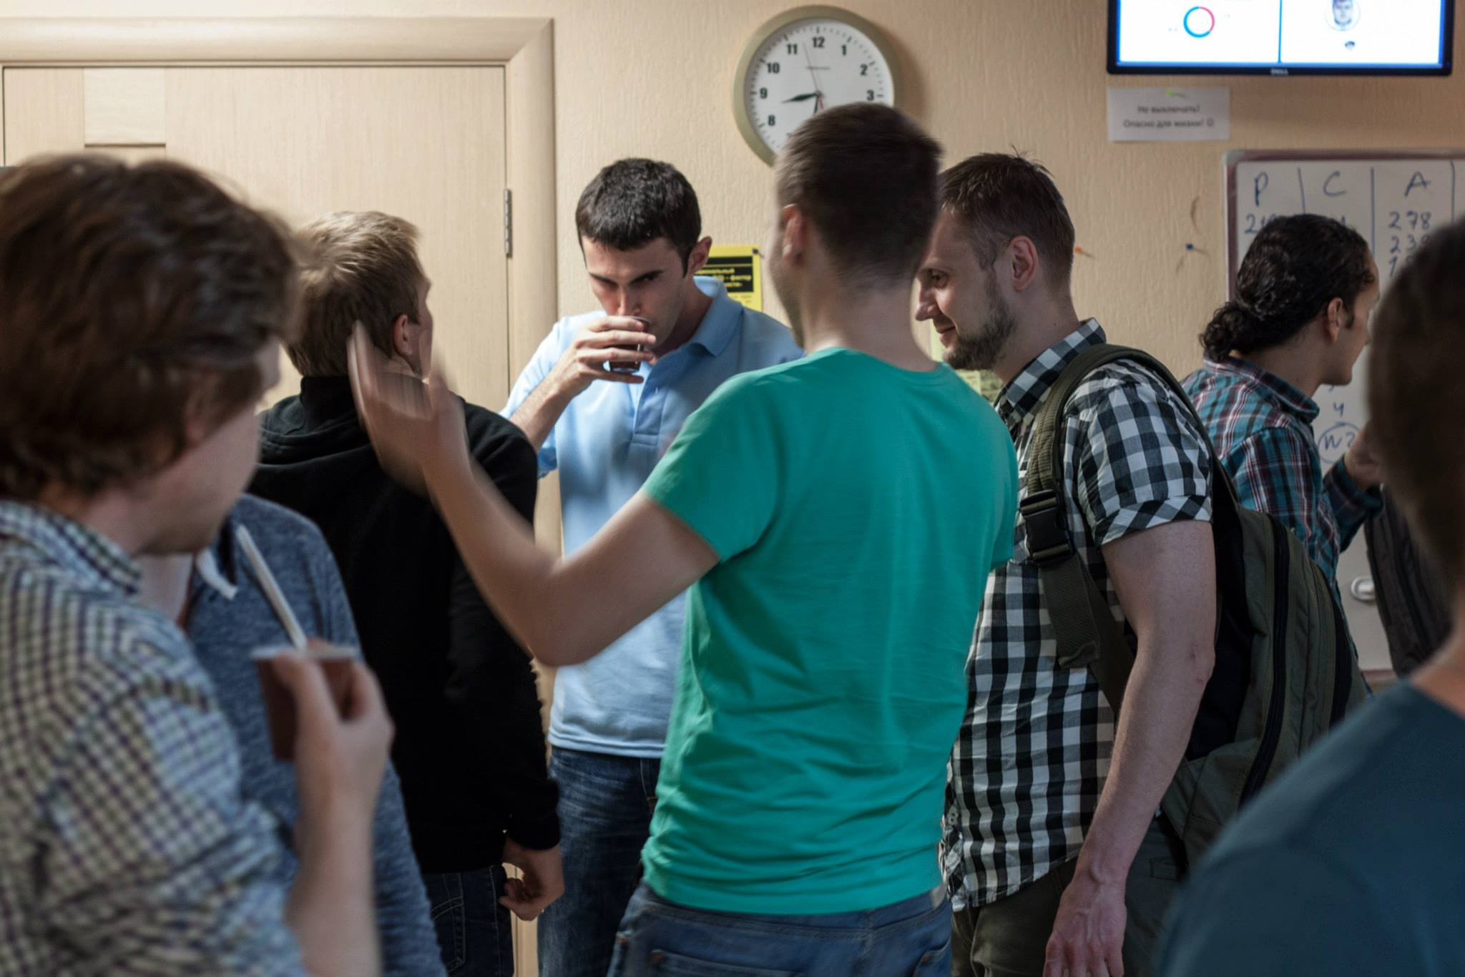
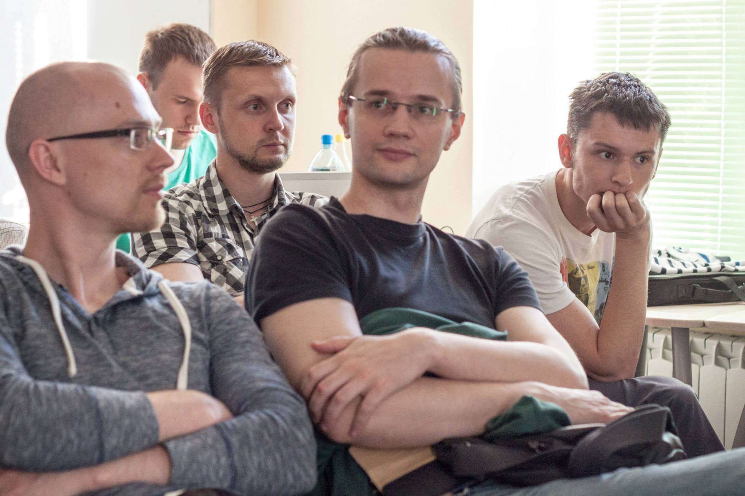
RS Meetup #1
- no budget
- 35 ppl

Slide 17
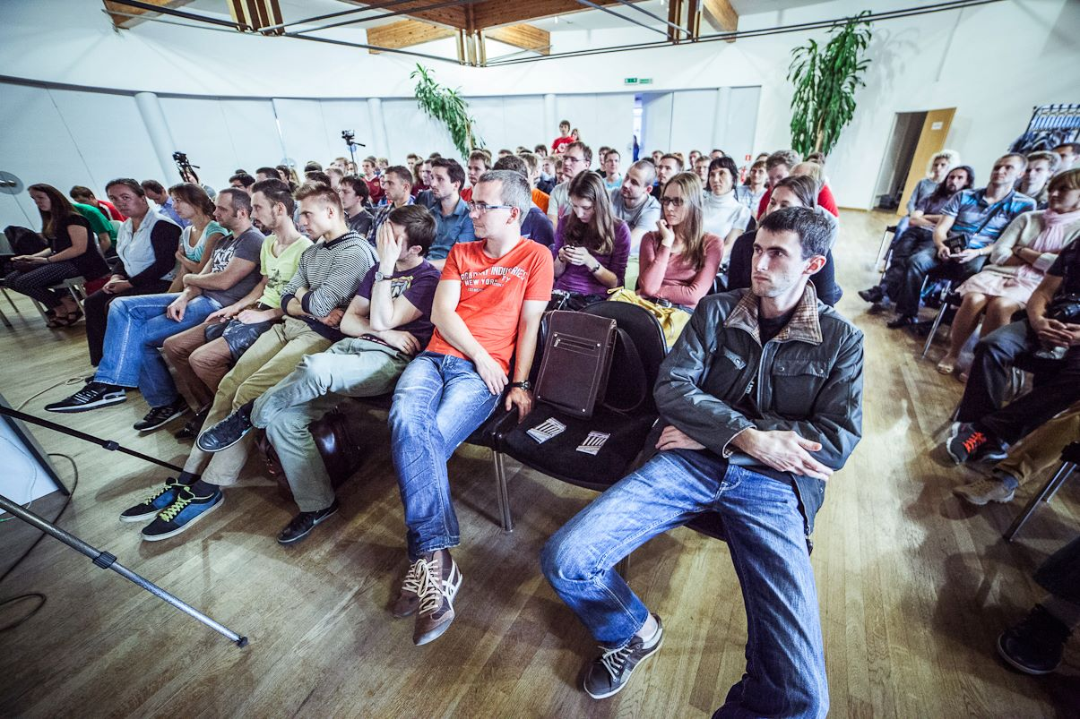
RS Meetup #4
- 220 ppl
- 5+ companies want to assist

Slide 18
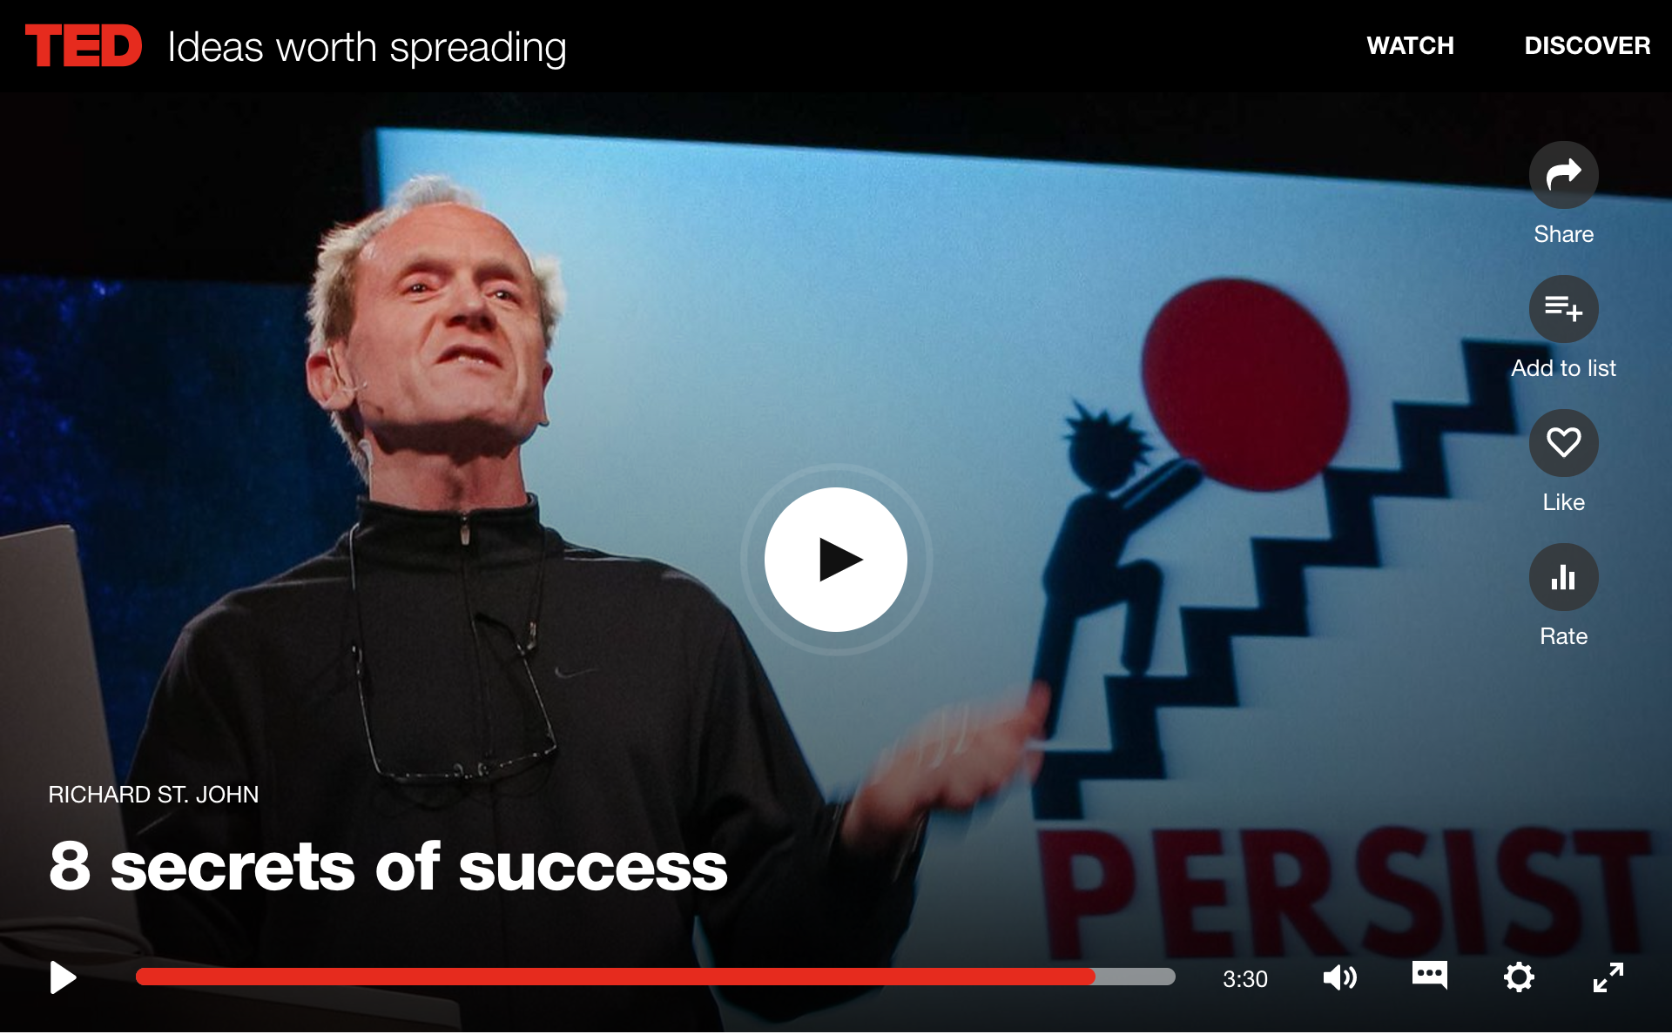
https://www.ted.com/talks/richard_st_john_s_8_secrets_of_success

Slide 19
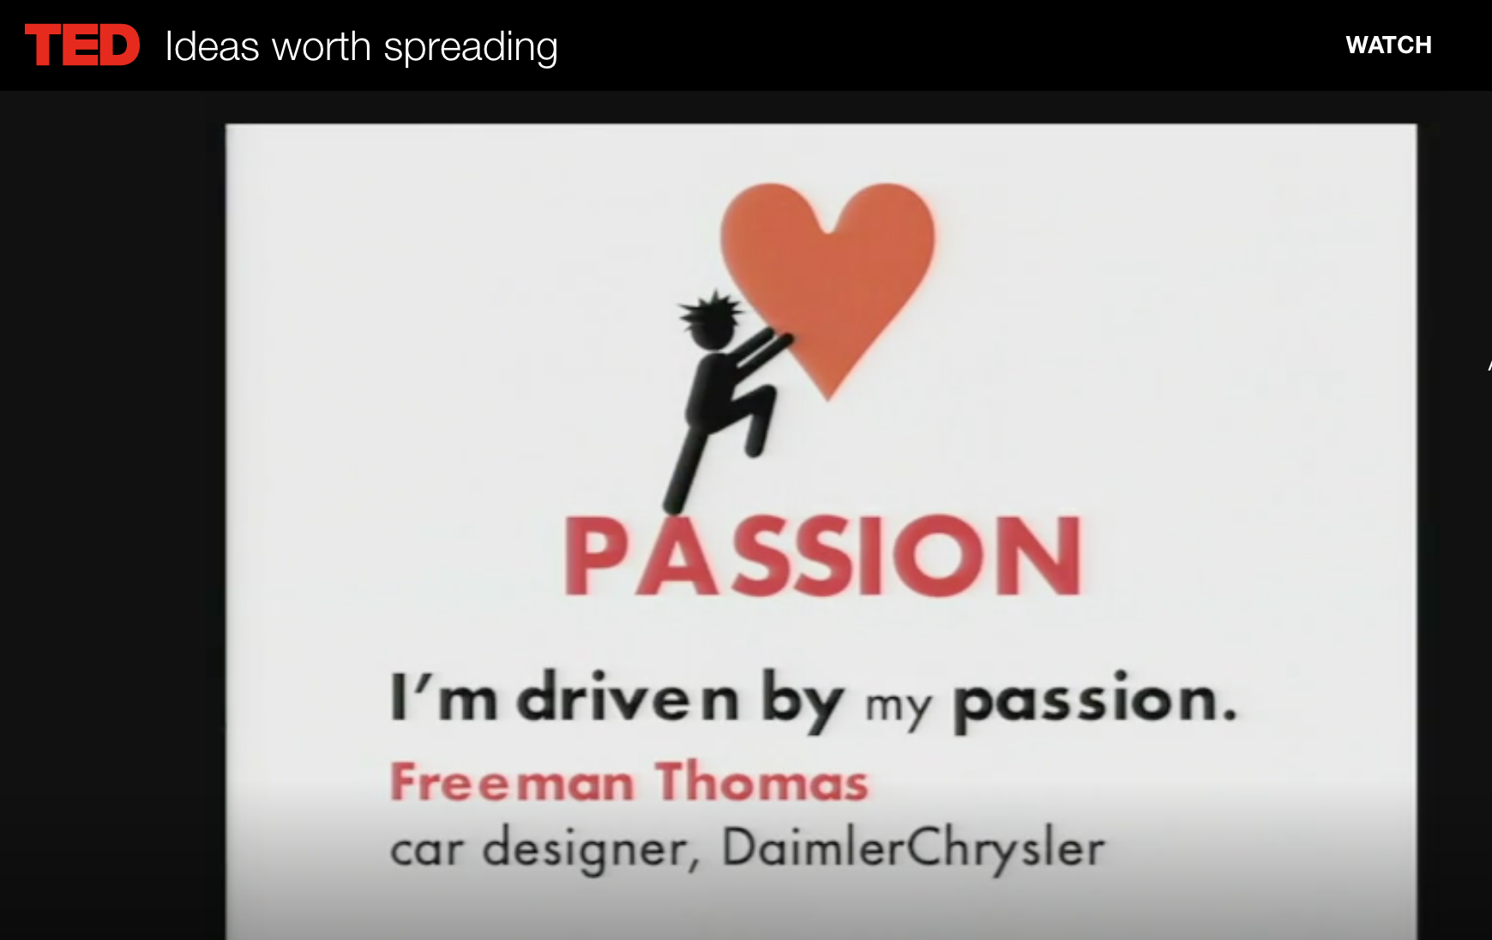

Slide 20
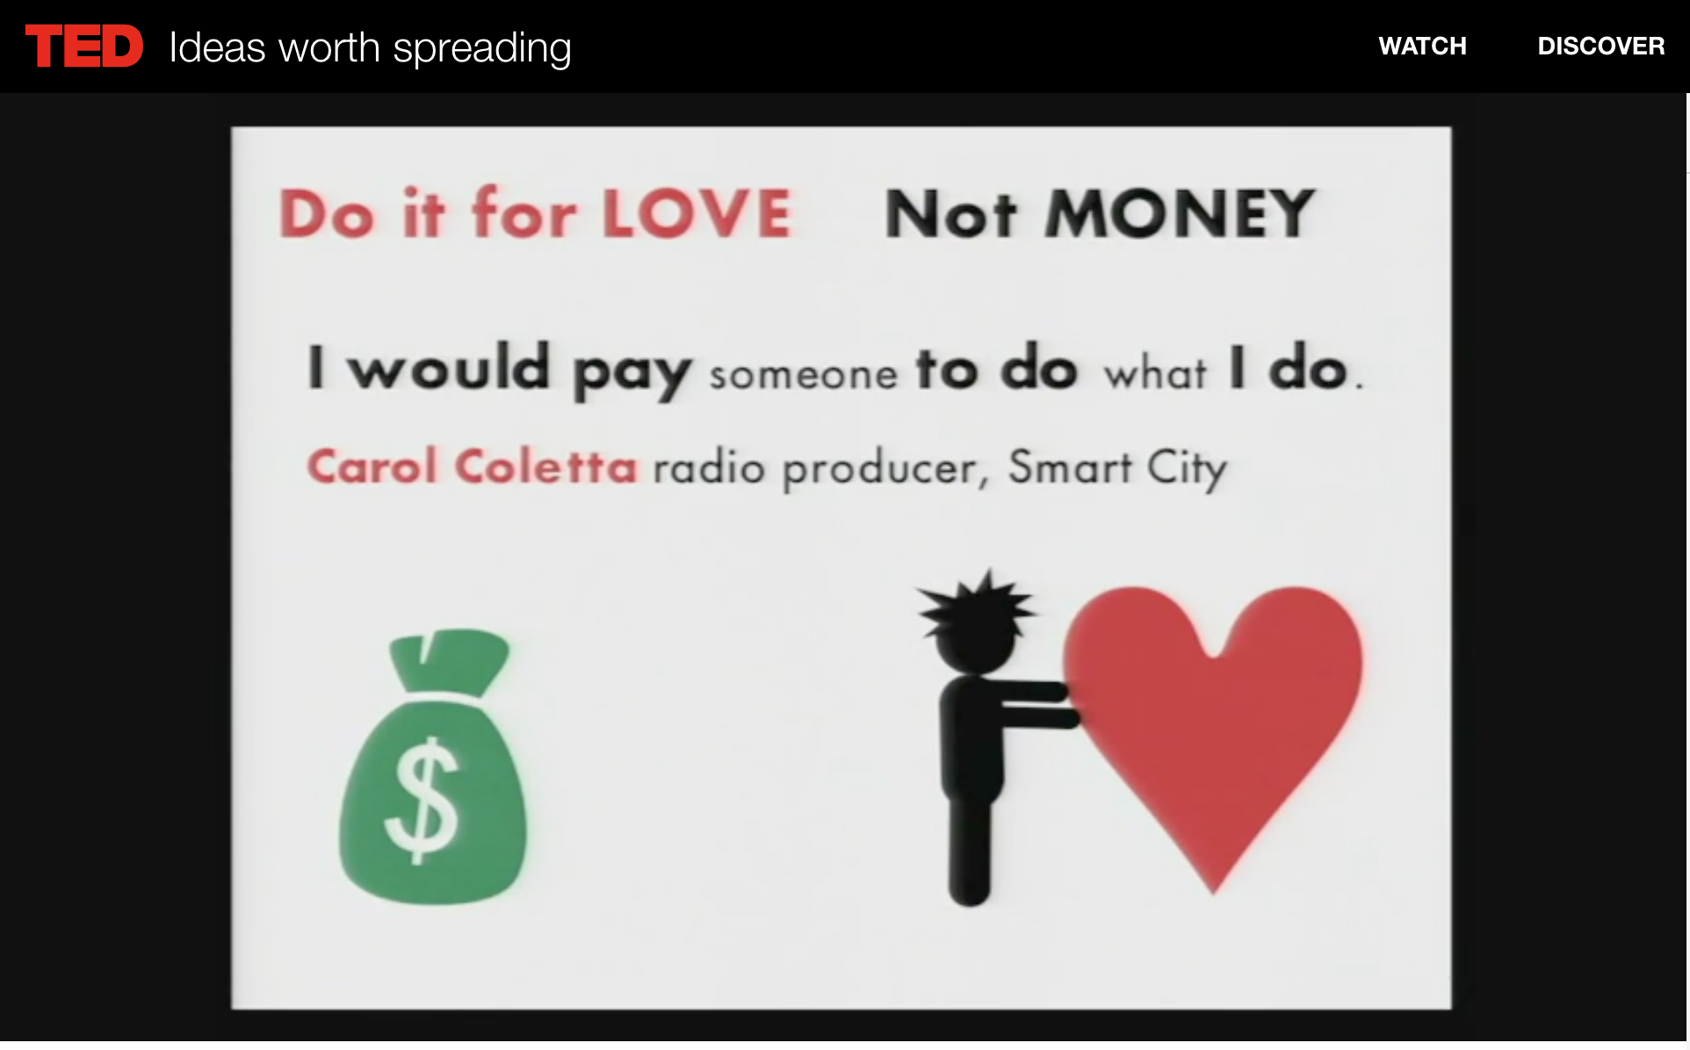

Slide 21
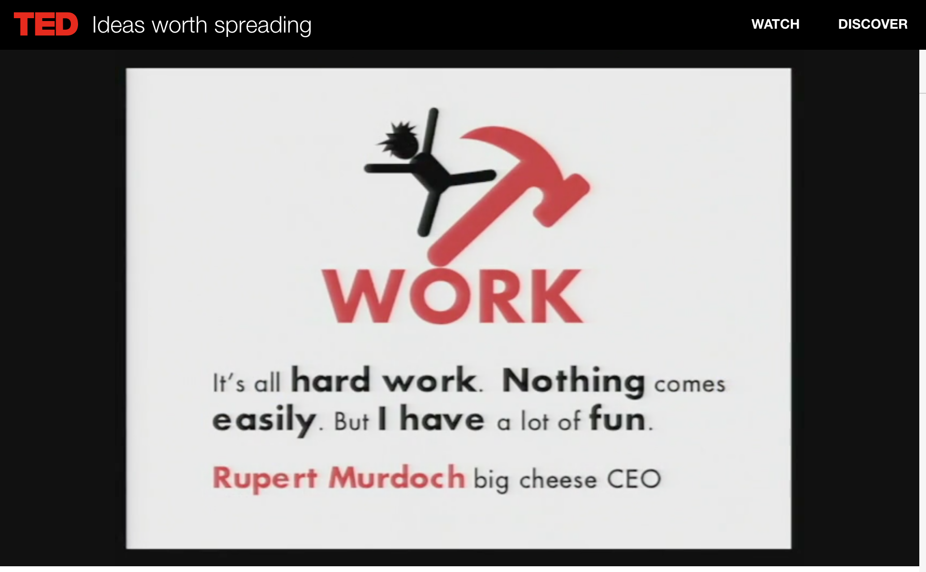

Slide 22
Great CREW

Slide 23
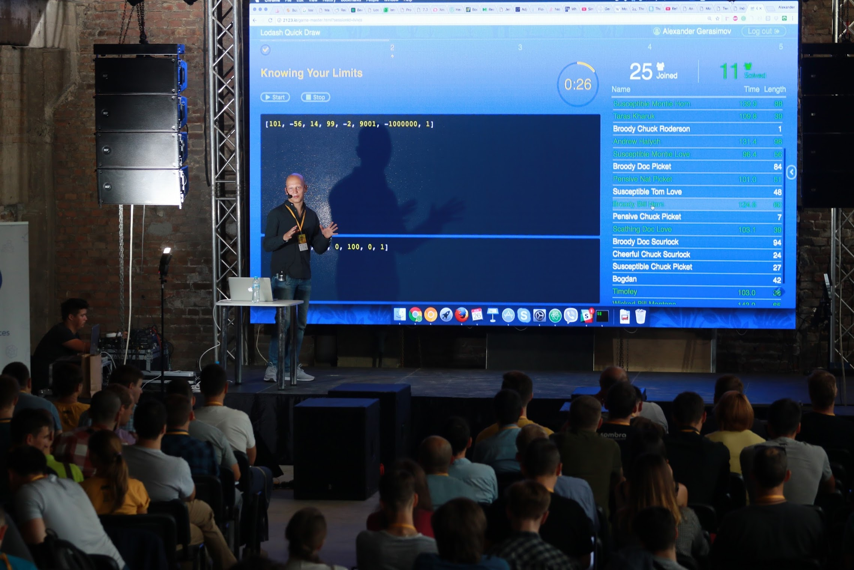
Here is Alex
He is passionate about FP, quizzes and challenges

Slide 24
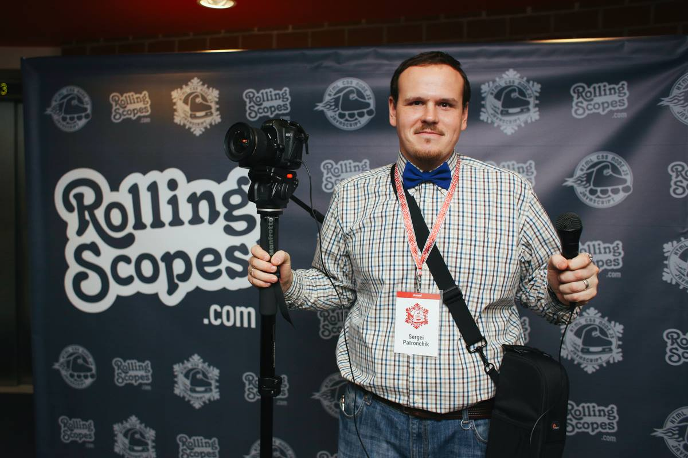
Here is Siarhei
He is passionate about photography

Slide 25
Here is Andrei
He is passionate about challenging tasks

Slide 26
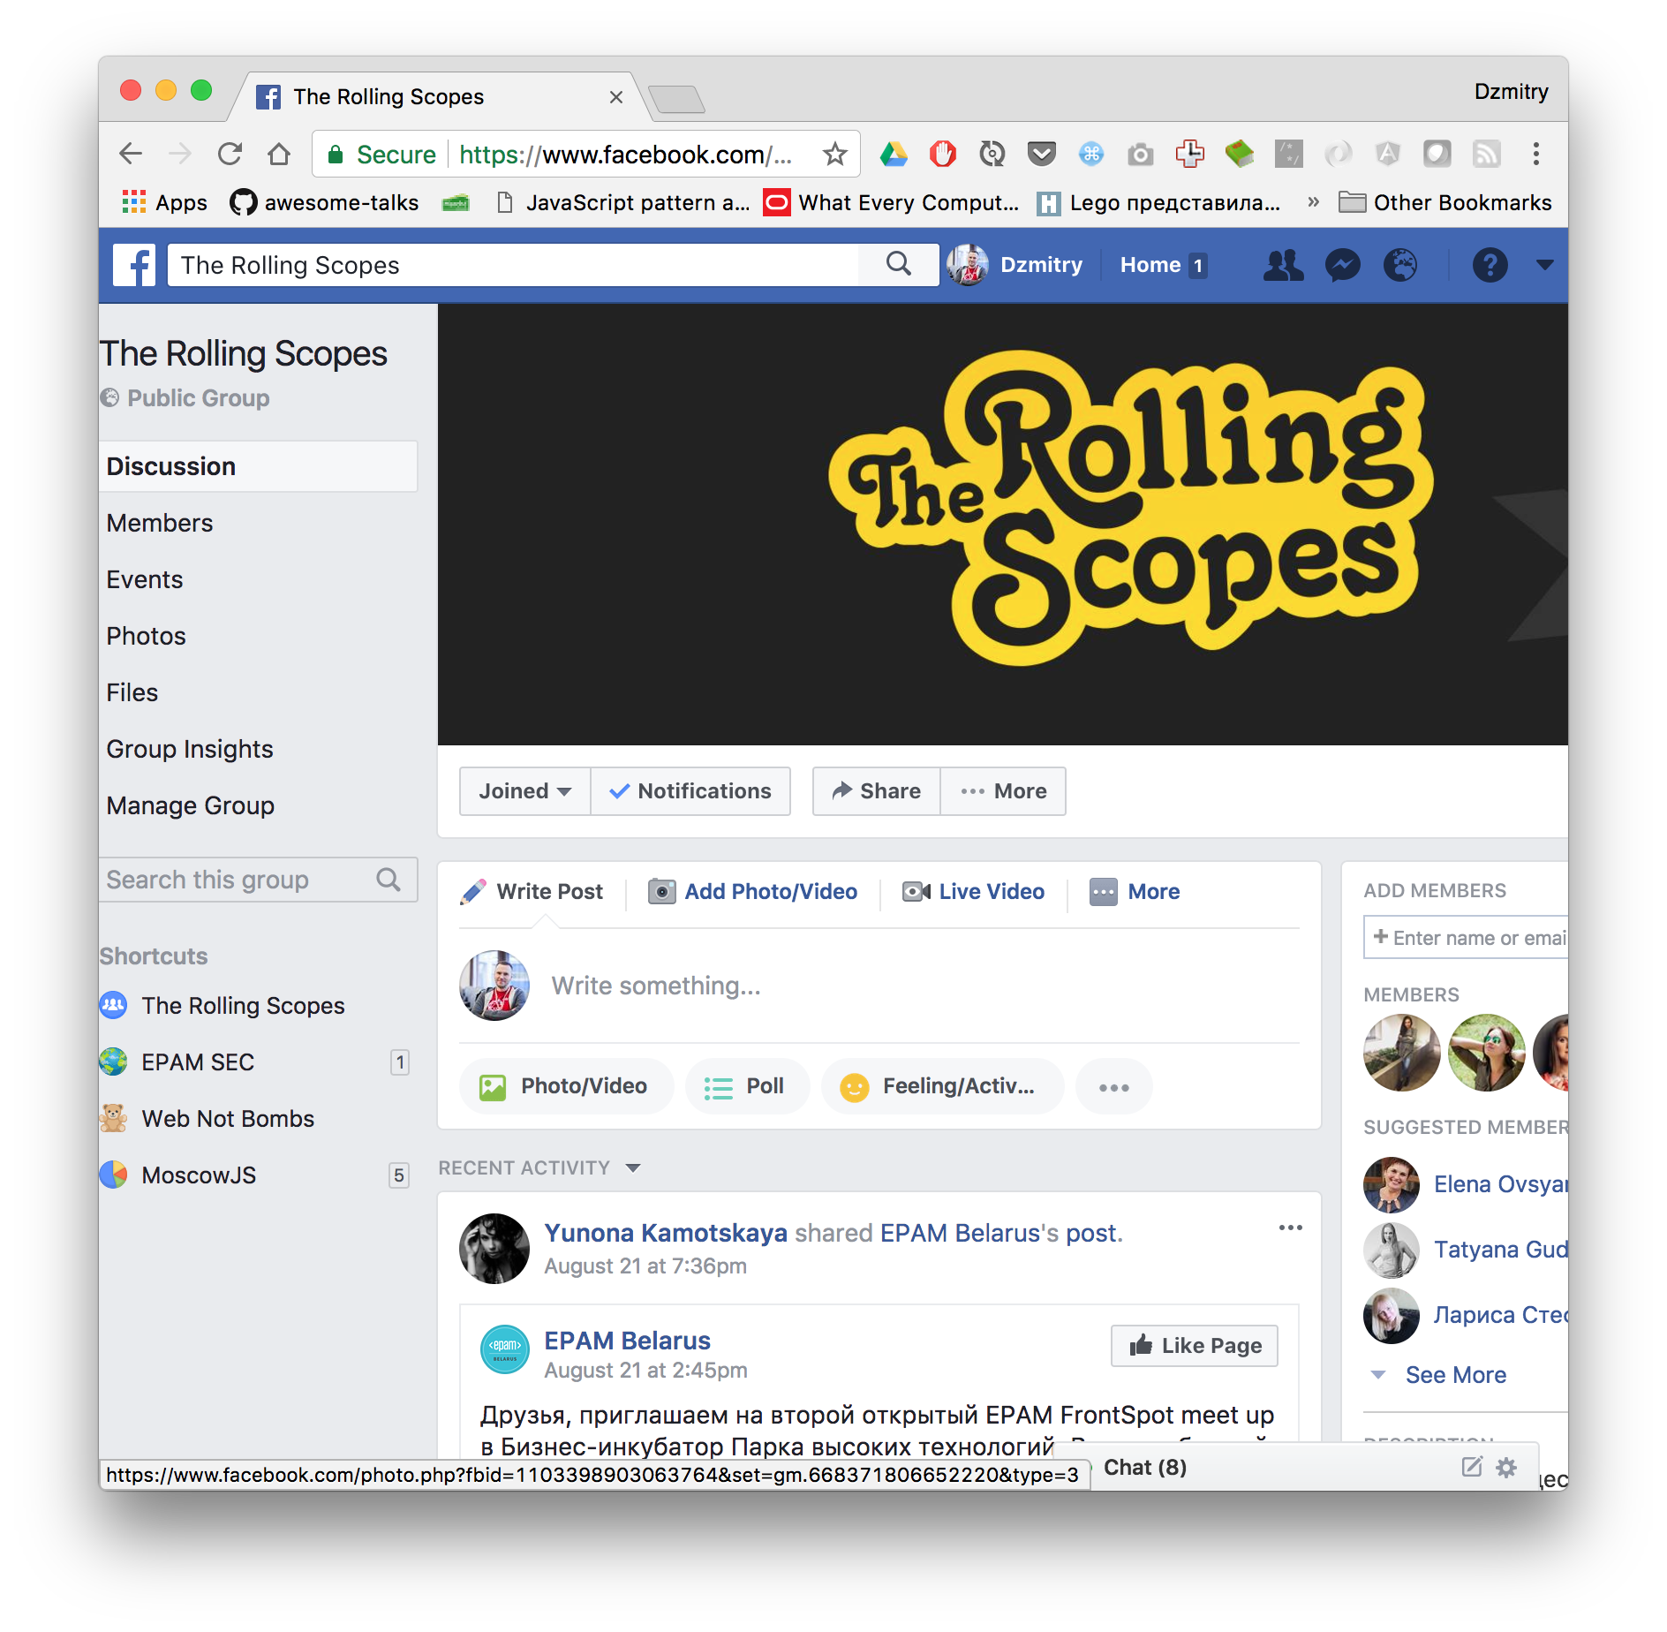
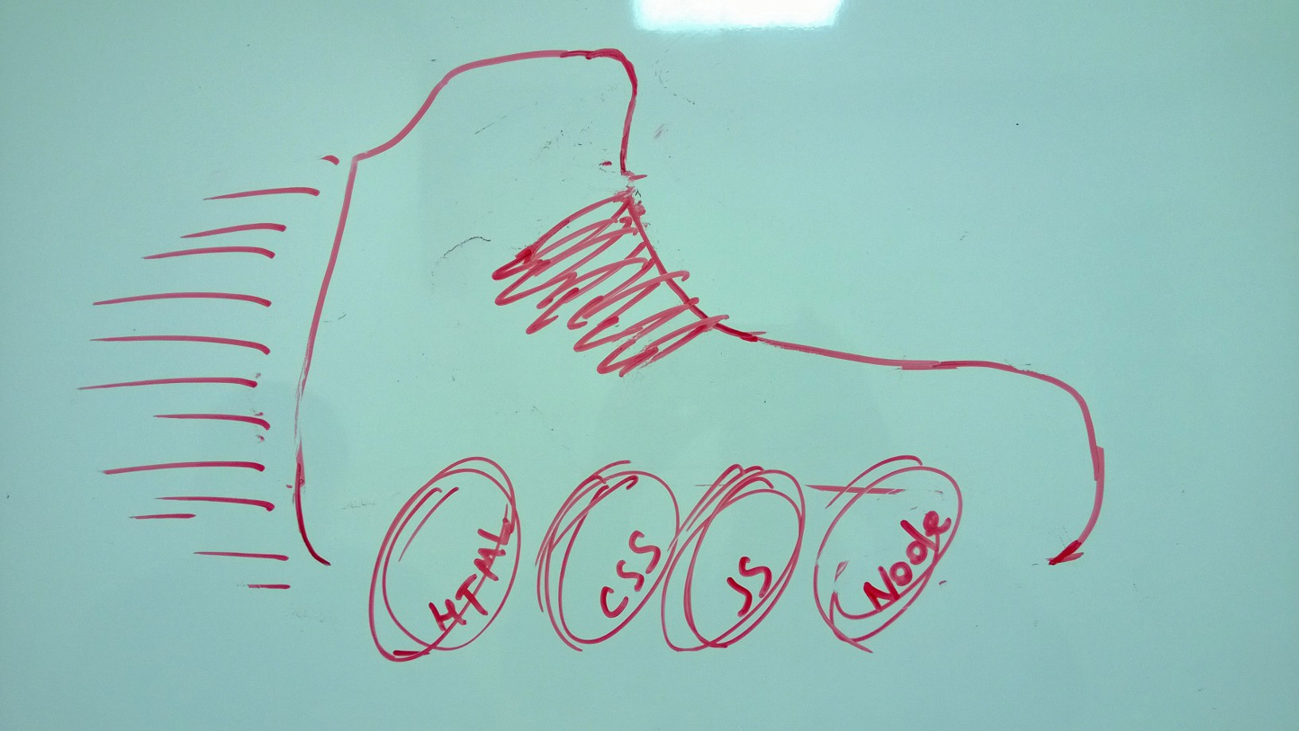
Here is Alex aka Carl
He is passionate about blogging

Slide 27
Here is Aliaksandr
He is passionate about education

Slide 28
Here is Aliaksei
He is passionate about Scratch

Slide 29
Here is Pavel
He is passionate about VR/AR

Slide 30
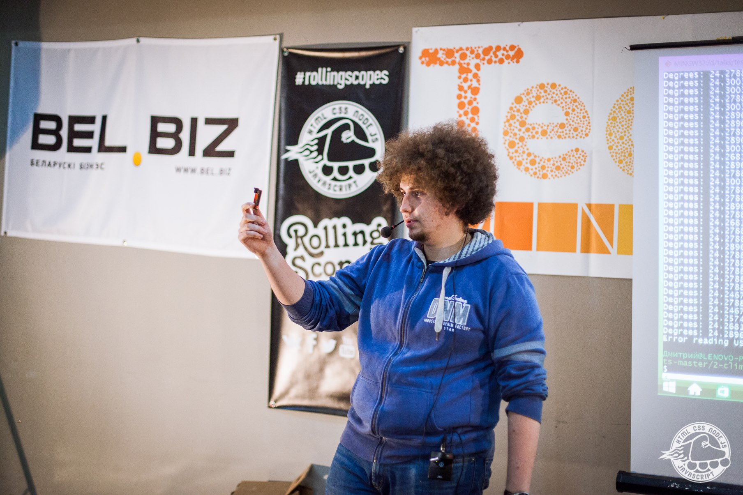
Here is Dzmitry
He is passionate about IoT

Slide 31
Here is our Community Management
They are passionate about community building

Slide 32
110+ Speakers

Slide 33
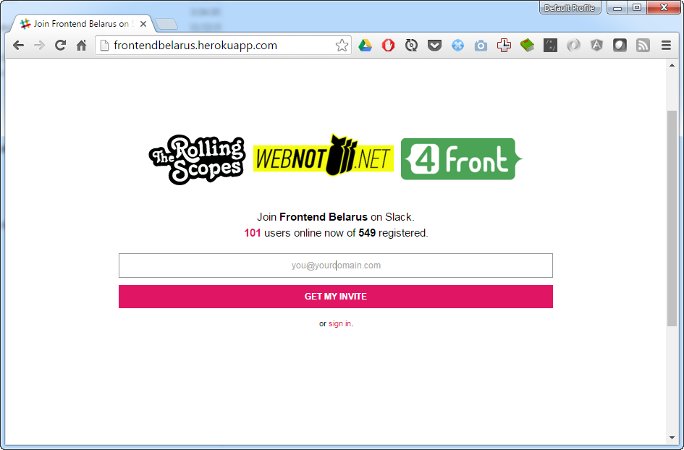
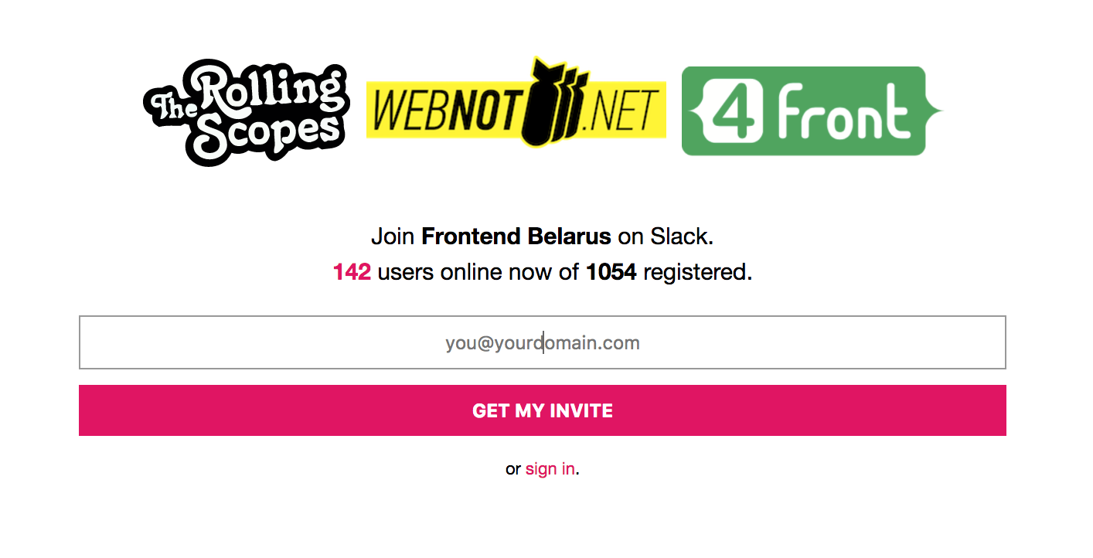
SLACK

Slide 34
Win-win situation
A win-win situation or result is one that is good for everyone who is involved

Slide 35
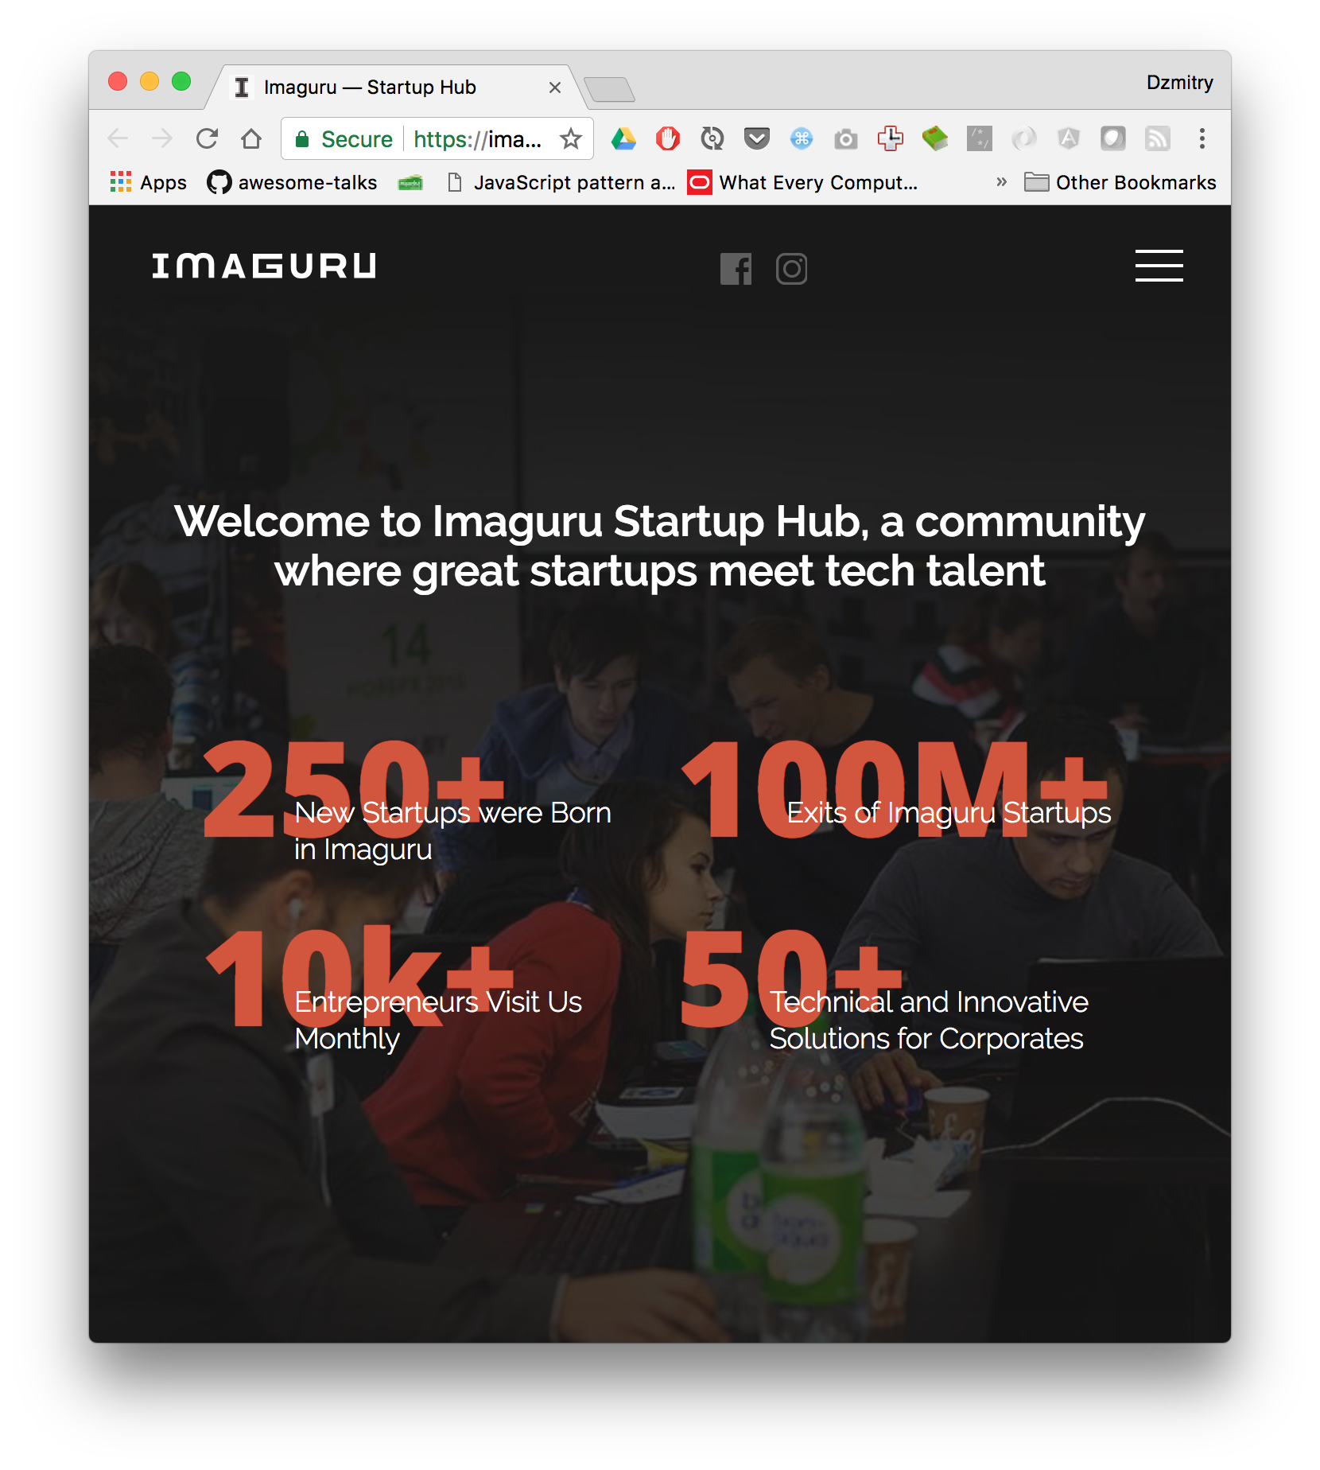
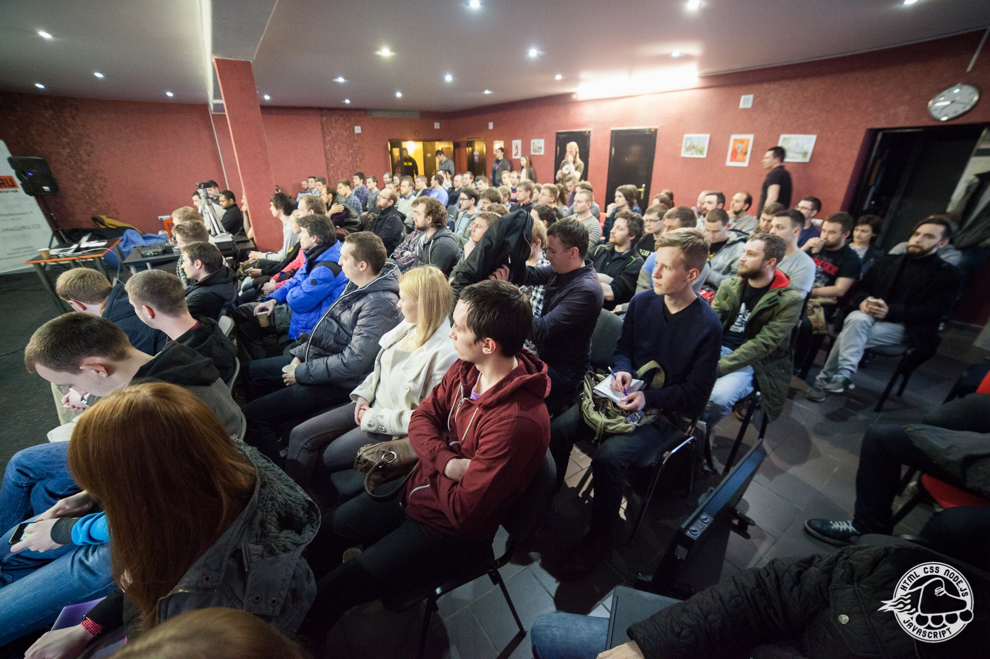
Meetups venue for free

Slide 36
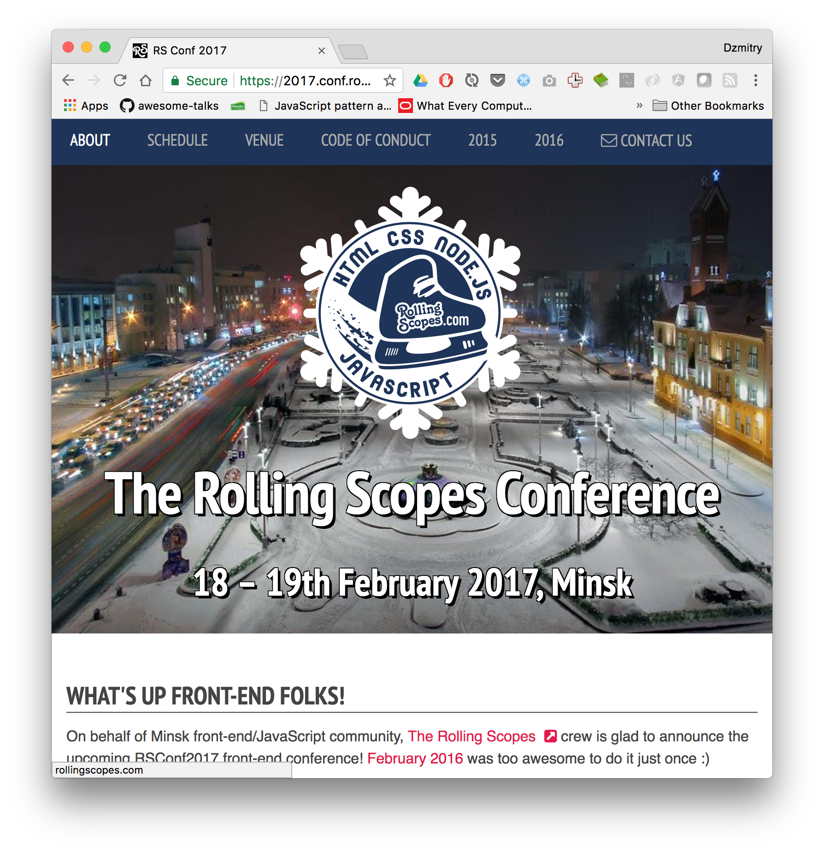
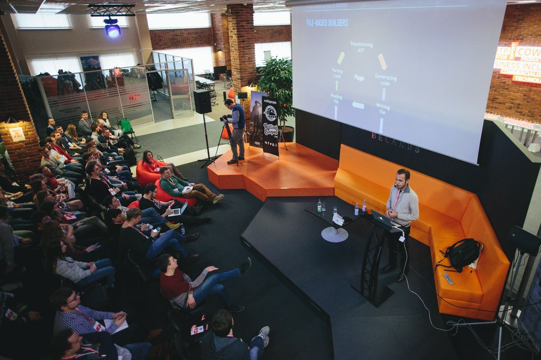
and even conference venue for free

Slide 38
PART III
Community building through education

Slide 39
The Rolling Scopes School
Offers:
- Free education
- Further employment in different companies

Slide 40
Now we grow 250 junior software engineers per semester

Slide 41

Main points:
Stage #1
860 ppl / 3 weeks
- 68 lectures
Stage #2
270 ppl / 3 month
- Six month
- Four stages
…
80 ppl

Slide 42
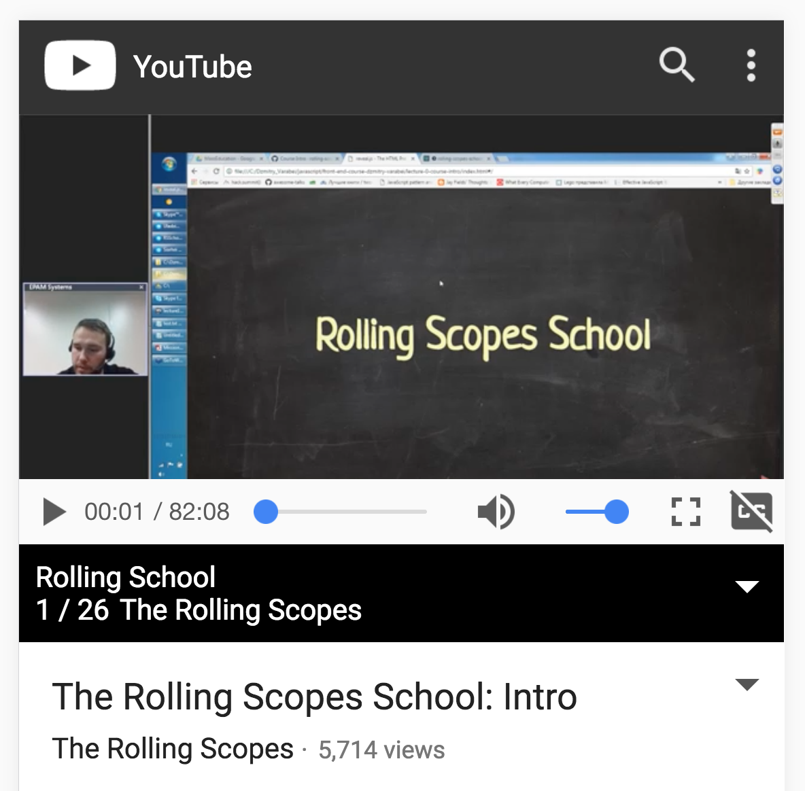
Stage #1
860 ppl / 3 weeks
- Everyone welcome
- No tests, no interviews, no contract for participating
- 10 introductory webinars
- several programming exercises to proceed to the next stage

Slide 43
Stage #1 to inform
To put in touch with:
our community
course atmosfere
education process
course road map

Slide 44
What next?

Slide 45
23 trainers for 68 lectures
Trainers:
- experienced and motivated community speakers
- from different companies and countries
⁃ choose 1-3 topics of expertise
- no long term obligation
⁃ enjoy the opportunity to be heard

Slide 47
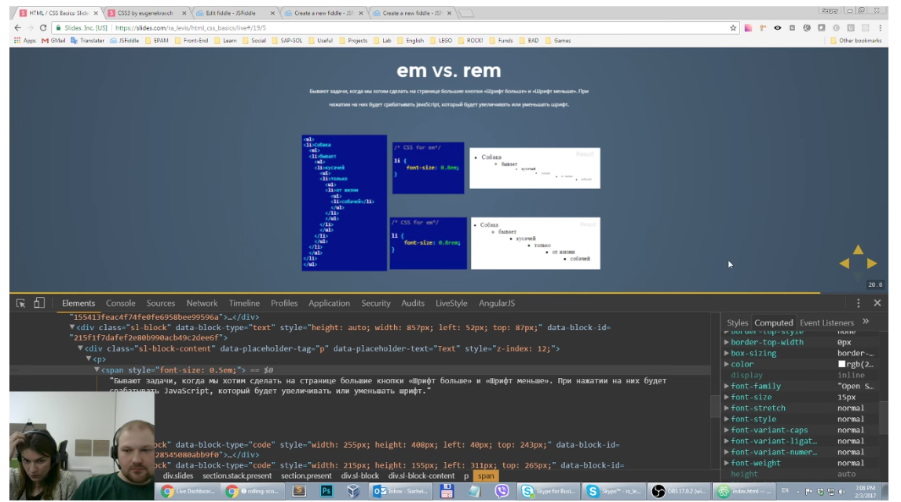
Lectures format
Online
Offline
Workshops
BeerJS

Slide 48
40+ Mentors to check home tasks
Mentors:
- grateful previously trained developers
- in charge for 5-10 people groups
- holding weekly group meetings
- check mentees tasks
- share their experience
- enjoy the process

Slide 49
Pay It Forward
We teach you
and you will teach others

Slide 50
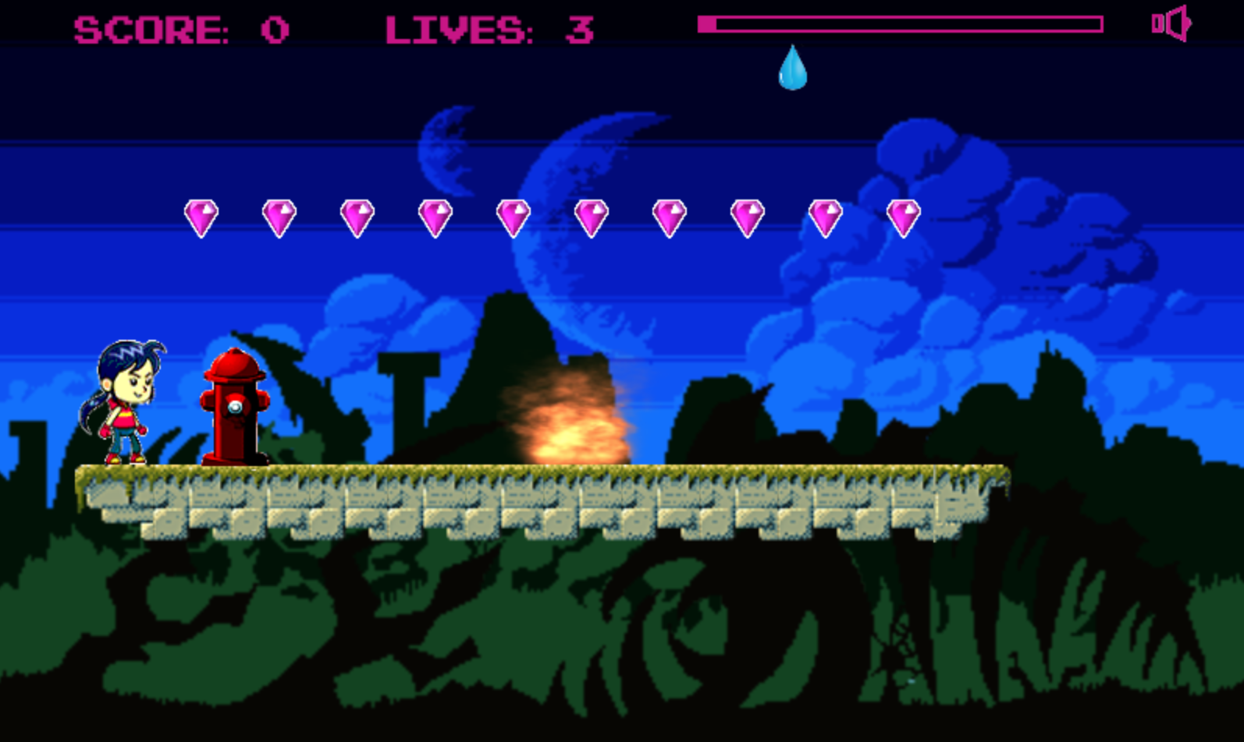
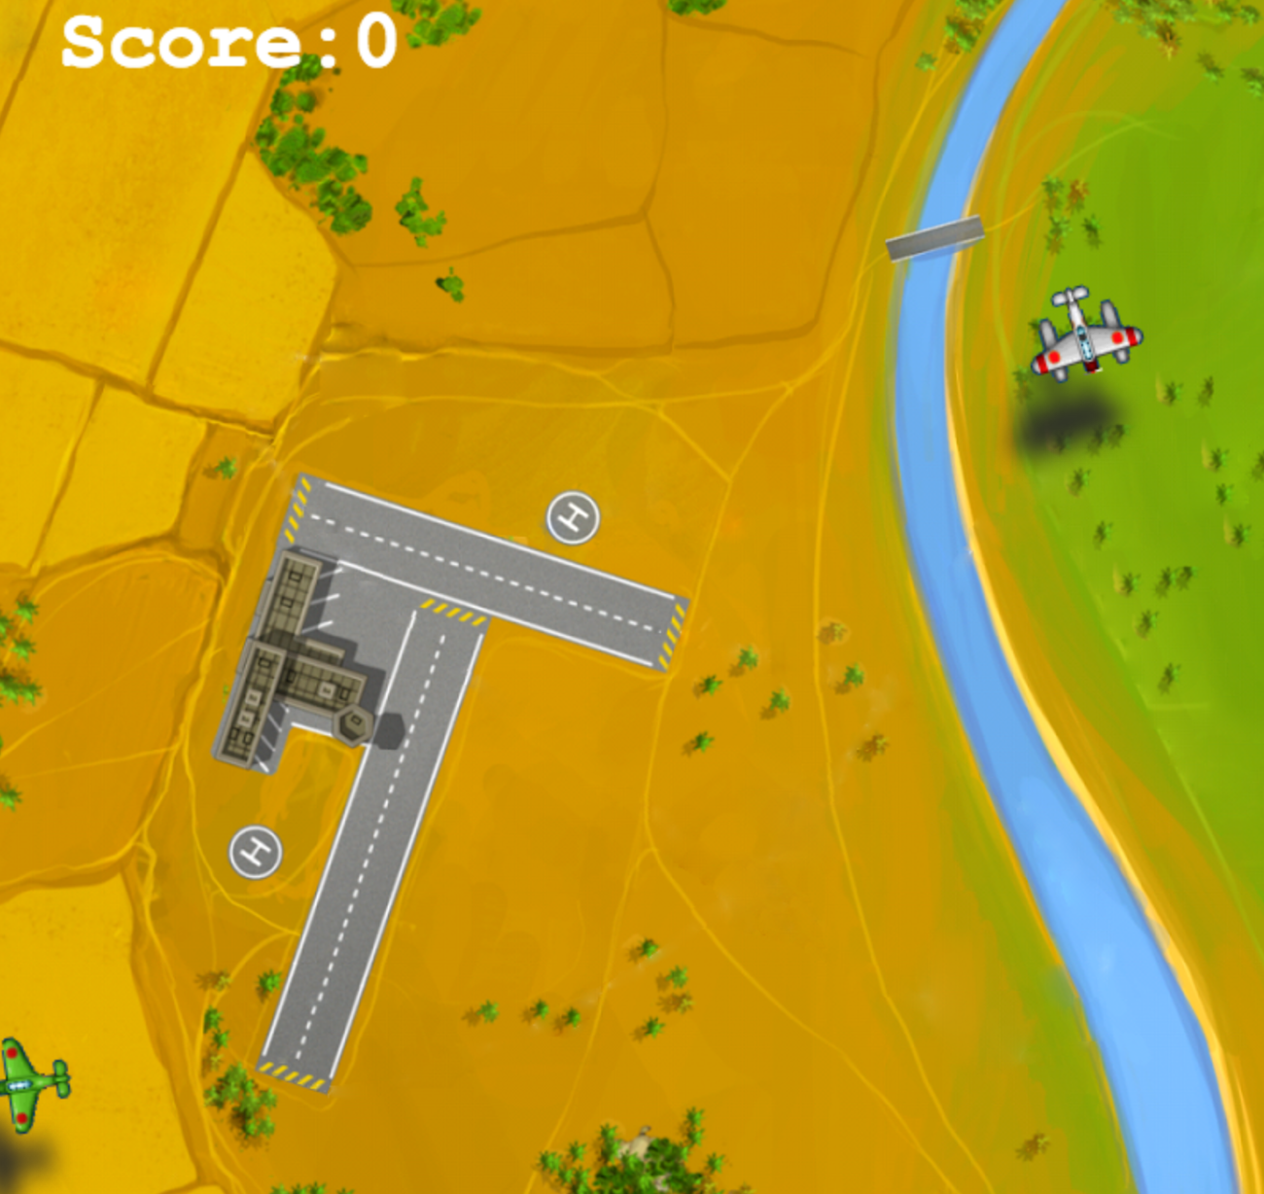

Tasks. No limits for creativity
- create a browser game
- prepare a short presentation

Slide 51
Tasks are for education
Competitions are for selection

Slide 52


Various programming challenges

Slide 53


Various programming challenges

Slide 54



Education materials is open sourced

Slide 55
Conclusion

Slide 56
What about the RS Budapest?

Slide 57

hank you!

